Slide 1
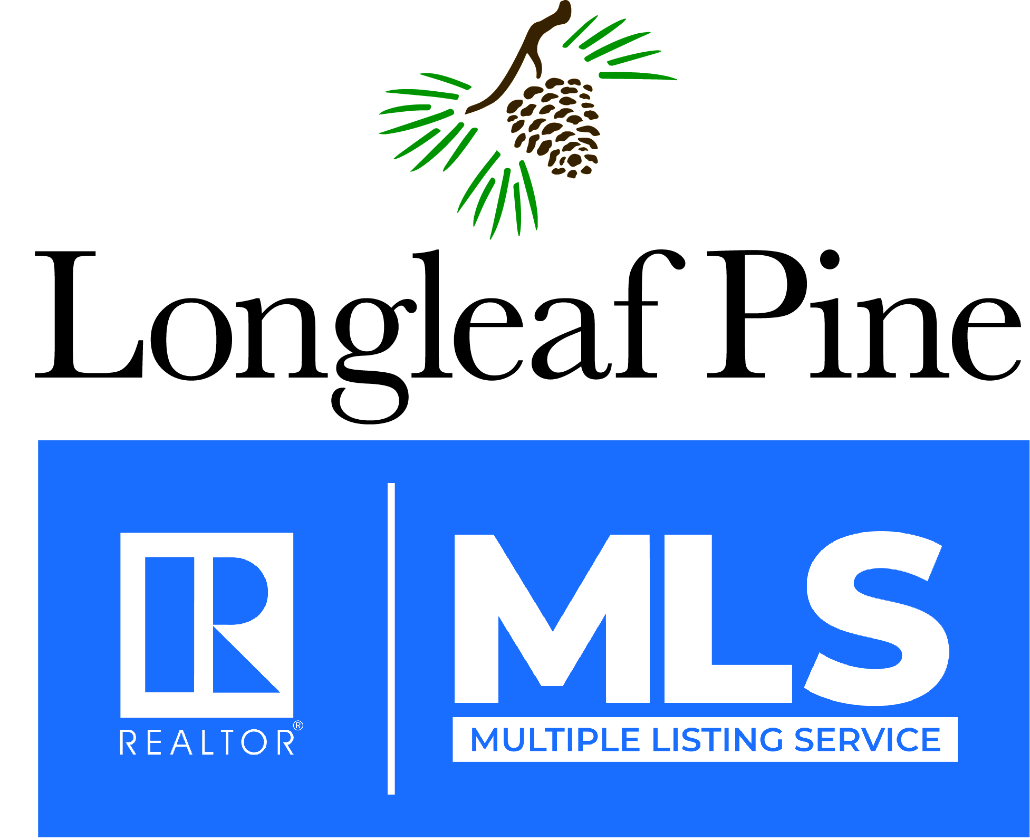
2022 State of the Real Estate Market

Slide 2
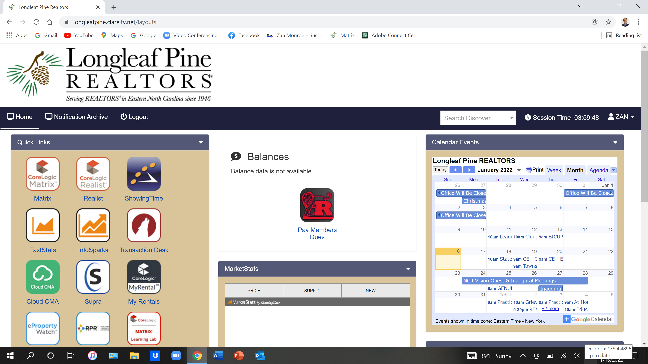

Slide 4
Entire MLS 2021 Market Data

Slide 5
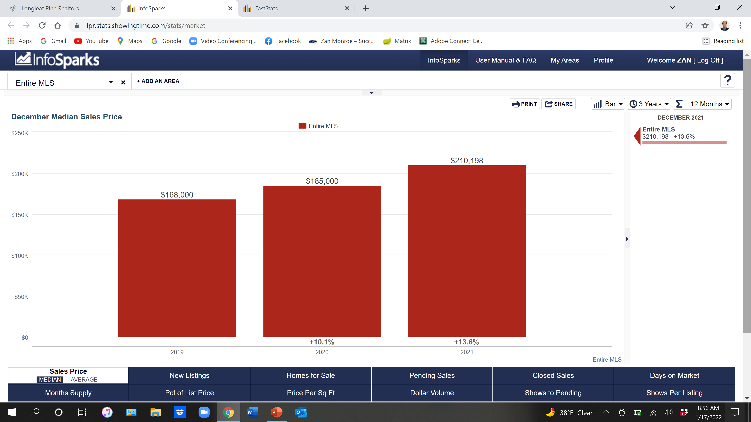
Median Sales Price $210,198 +13.6% +23.7% since 2020

Slide 6
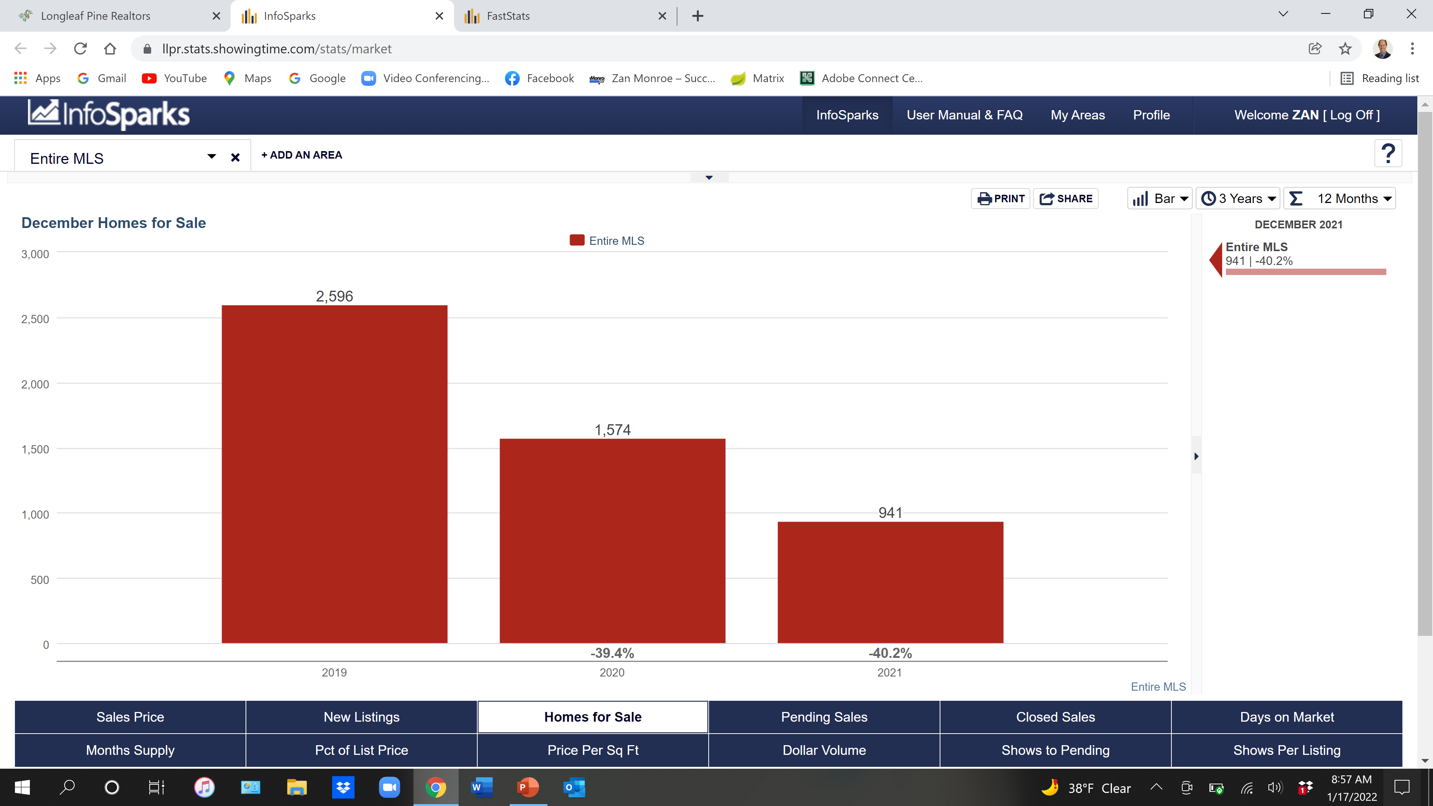
941 Homes for Sale - 40.2%

Slide 7
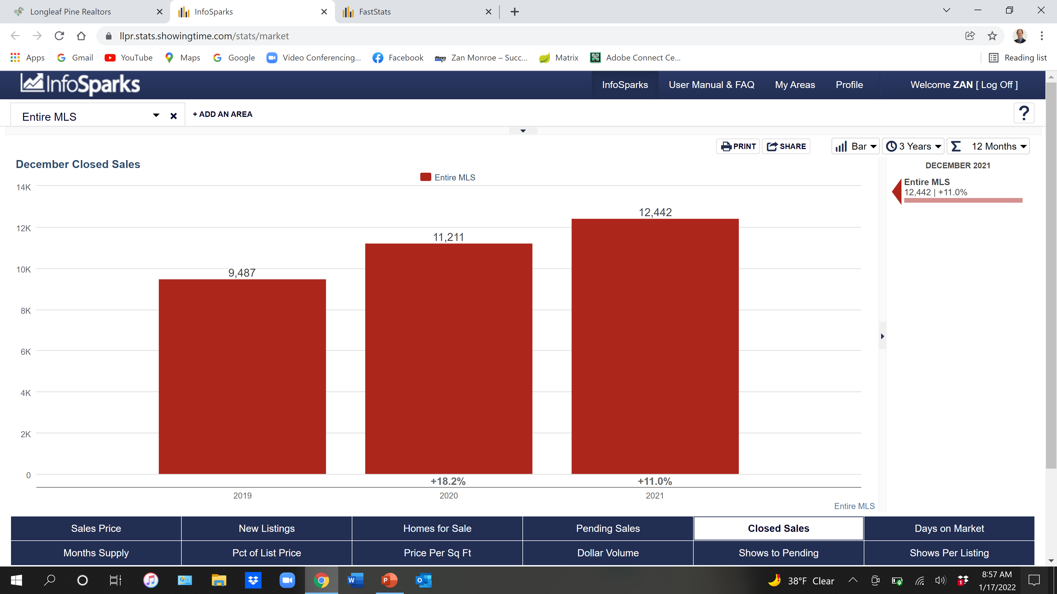
12,442 Closed Sales +11.0% +29.2% since 2020

Slide 8
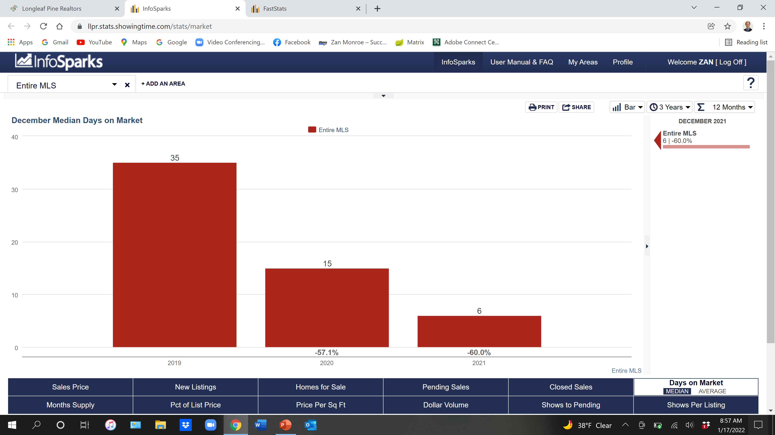
6 Days on Market

Slide 9
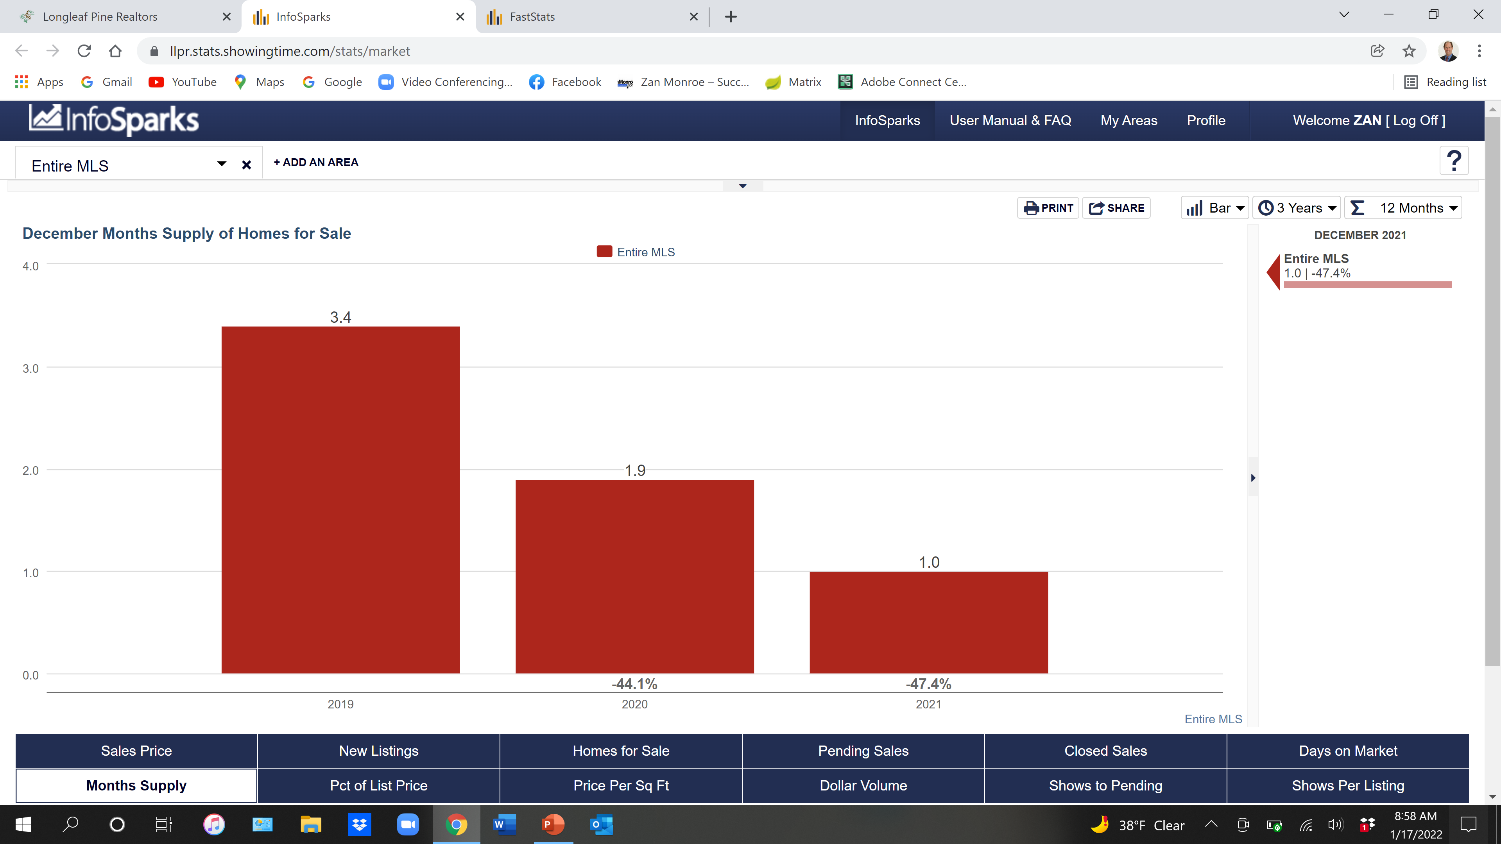
1 Months Supply

Slide 10
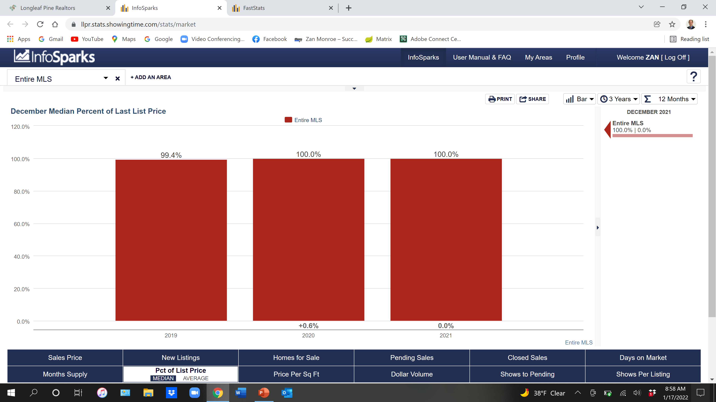
100% of Sales Price

Slide 11
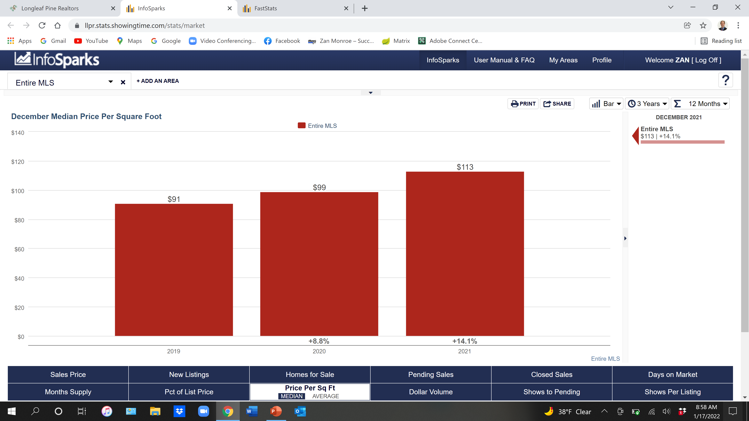
$113 Per Sq Ft = +14.1% +22.9% since 2020

Slide 12
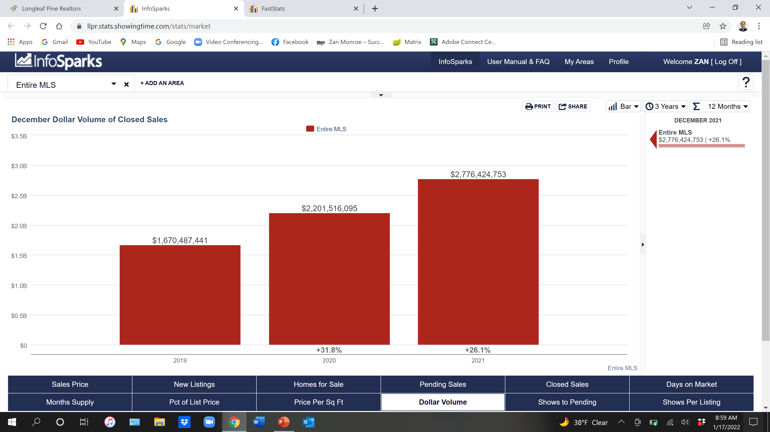
$2.7 Billion in Sales + 26.1%

Slide 13
2021 Cumberland County

Slide 14
Cumberland County 2021 Single Family - Existing

Slide 15
Cumberland County 2021 Single Family - Existing
5,766 Closed
$185,000 Median Sales Price

Slide 16
Cumberland County 2021 New Construction

Slide 17
Cumberland County 2021 New Construction
454 Closed
$284,925 Median Sales Price

Slide 18
Cumberland County 2021 Townhouse/Condo

Slide 19
Cumberland County 2021 Townhouse/Condo
472 Closed
$95,250 Median Sales Price

Slide 20
Cumberland County Sales Price

Slide 21
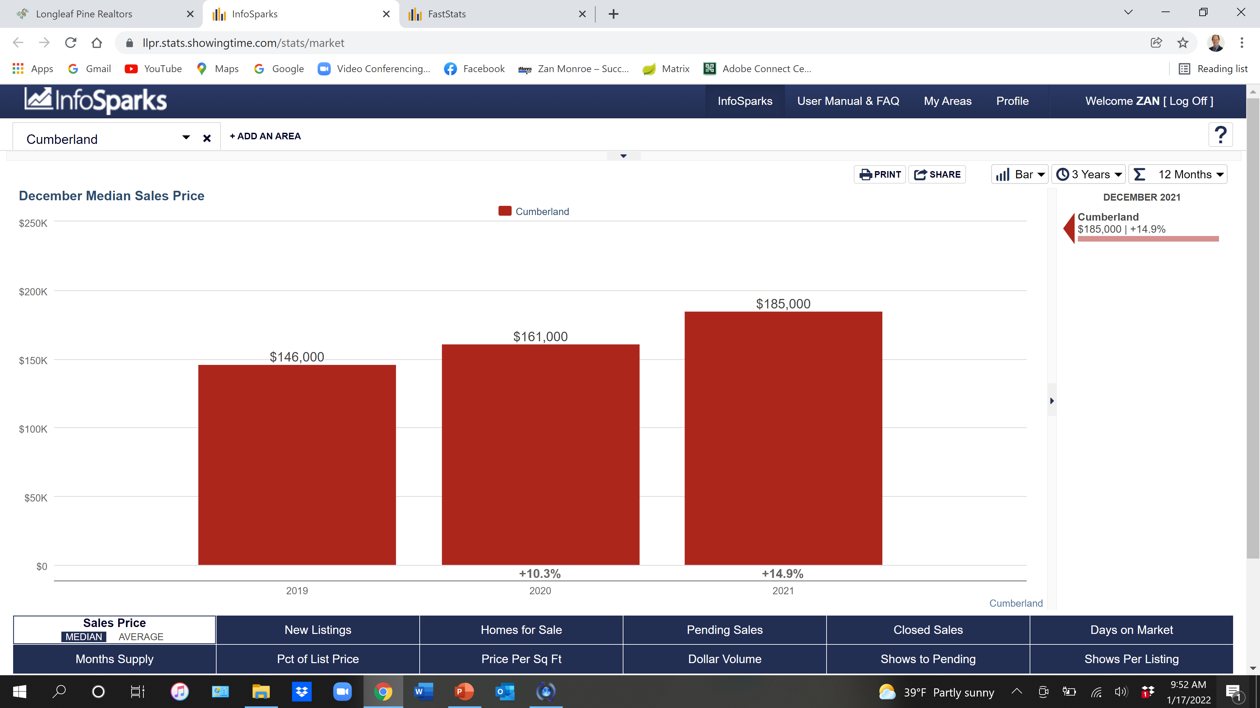

Slide 22
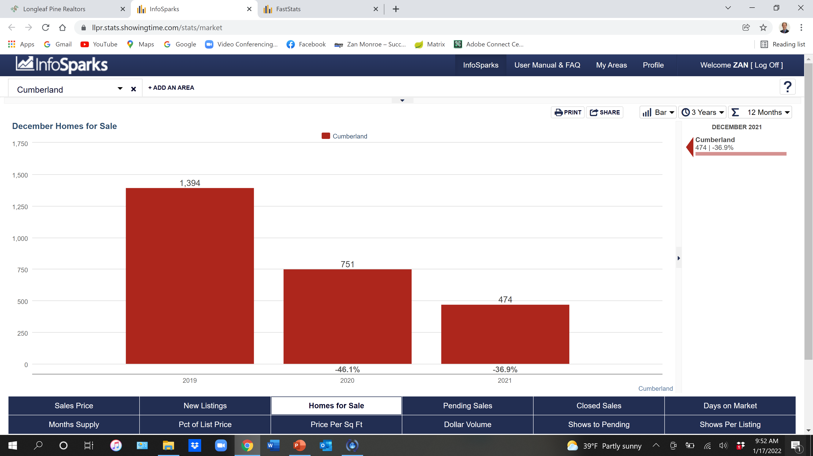

Slide 23
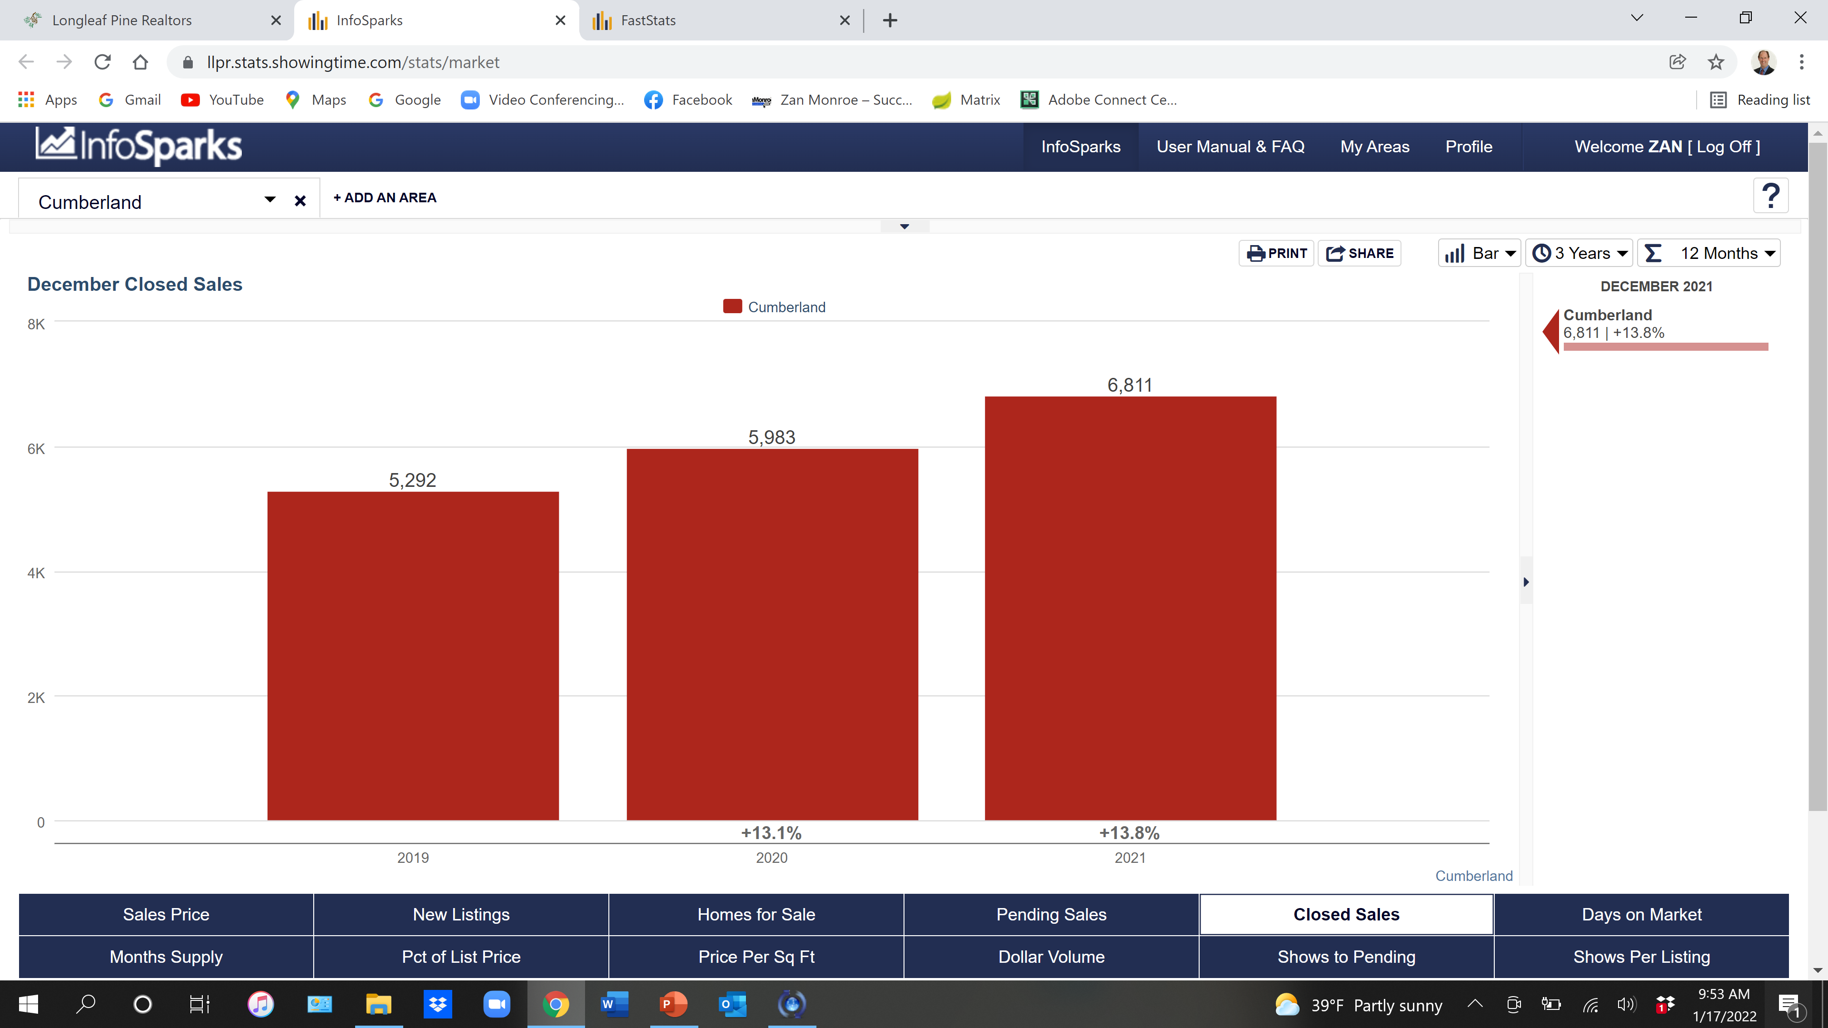

Slide 24
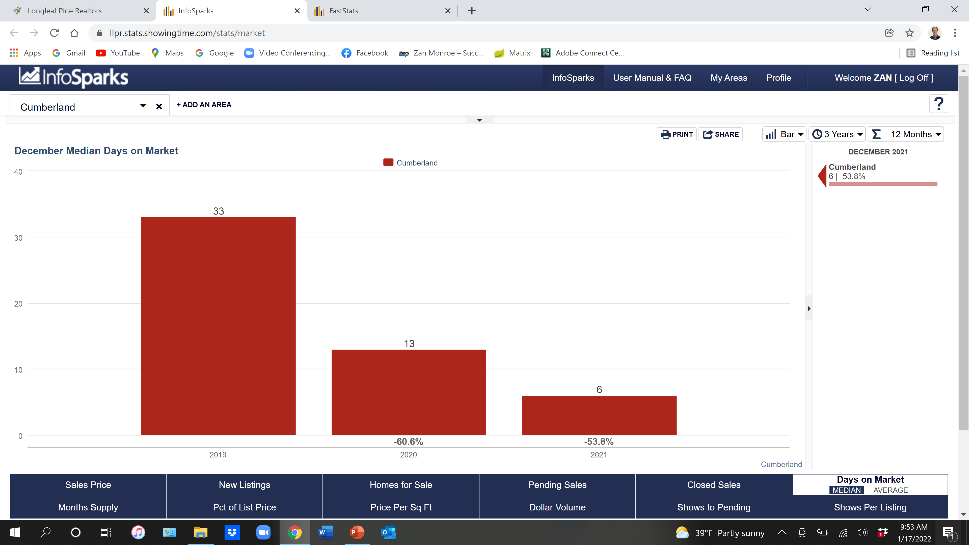

Slide 25
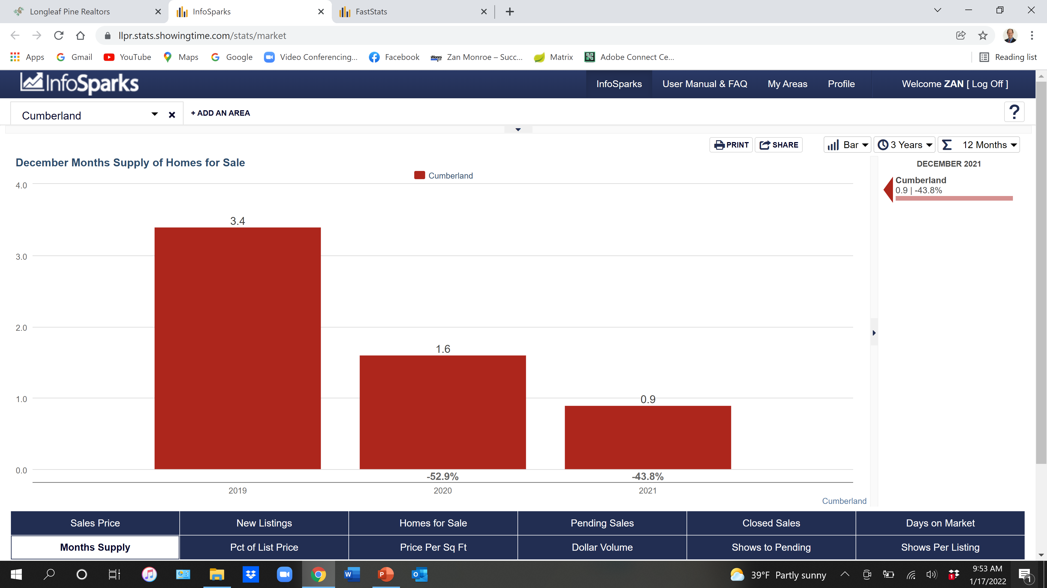

Slide 26
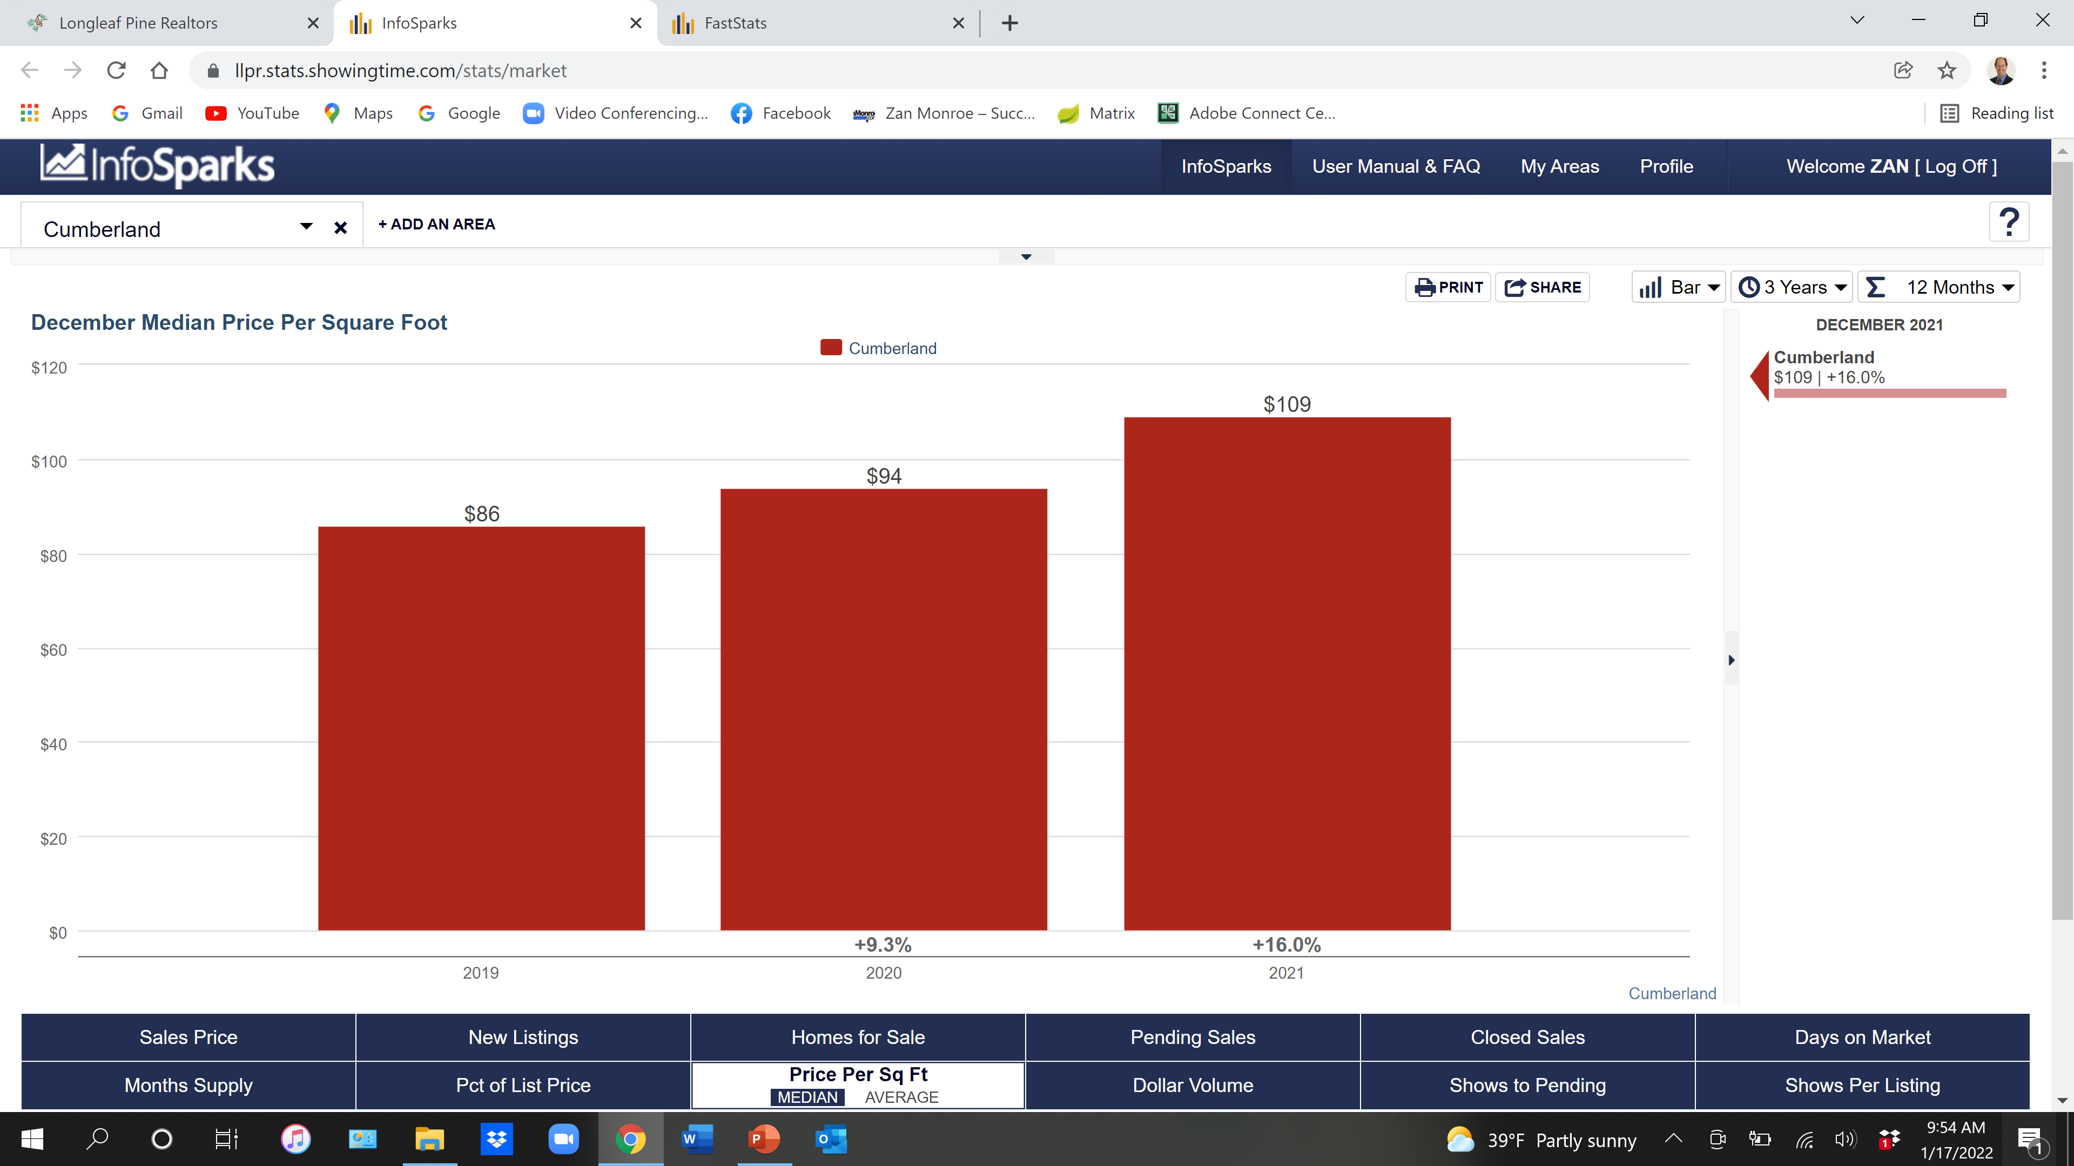

Slide 27
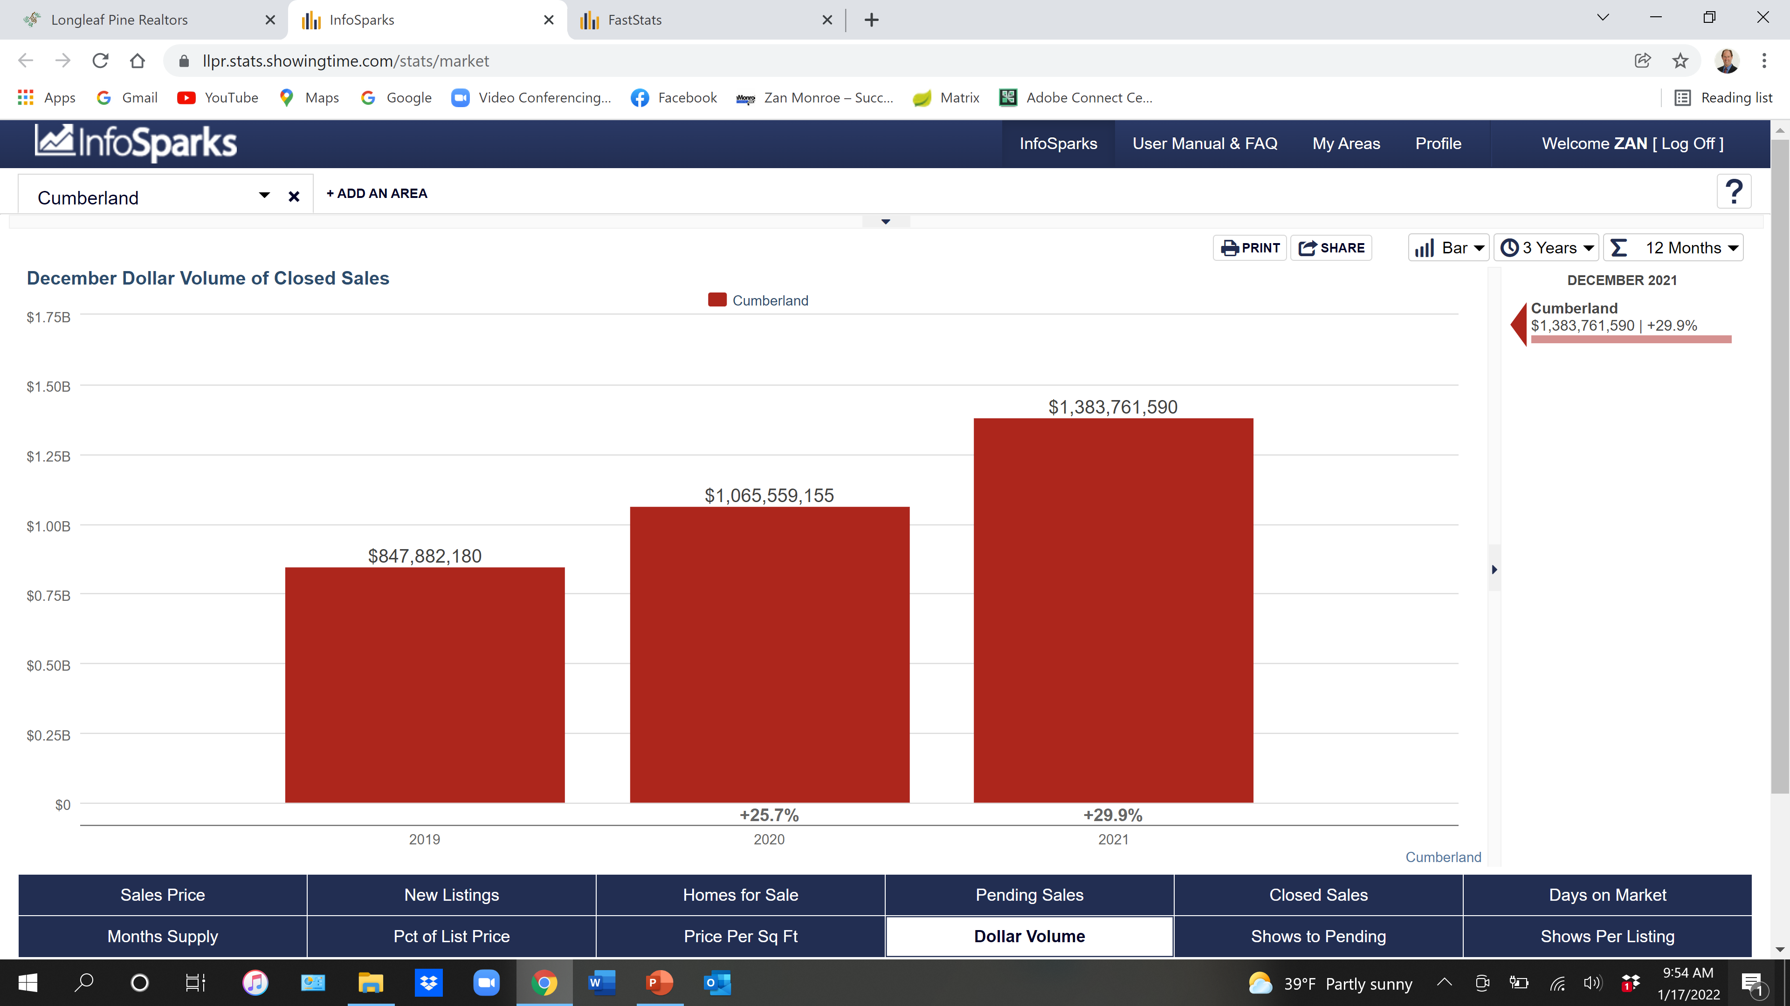

Slide 28
2021 Harnett County

Slide 29
2021 Harnett County Single Family Existing

Slide 30
Harnett County 2021 Single Family Existing
1,630 Closed
$252,000 Median Sales Price

Slide 31
2021 Harnett County New Construction

Slide 32
Harnett County 2021 New Construction
351 Closed
$275,027 Median Sales Price

Slide 33
2021 Harnett County Townhouse/Condo

Slide 34
Harnett County 2021 Townhouse/Condo
24 Closed
$186,000 Median Sales Price

Slide 35
2021 Harnett County Sales Price

Slide 36
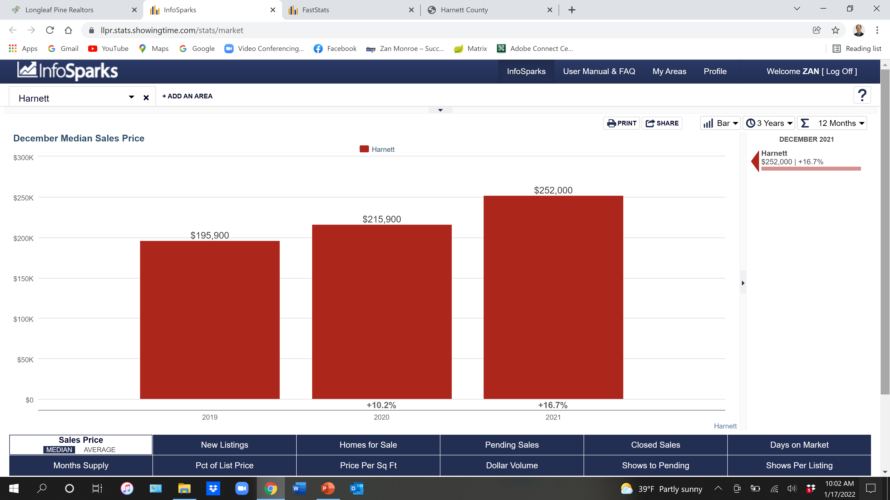

Slide 37
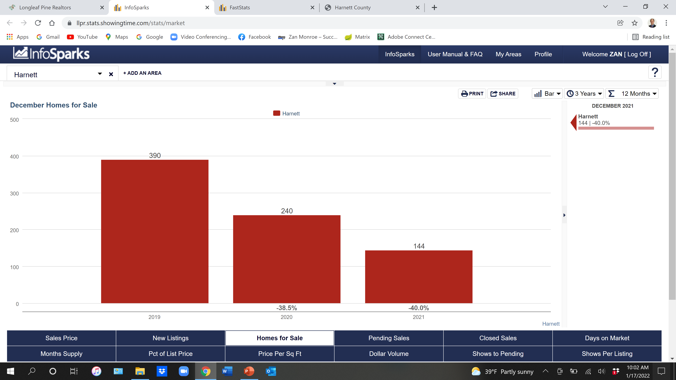

Slide 38
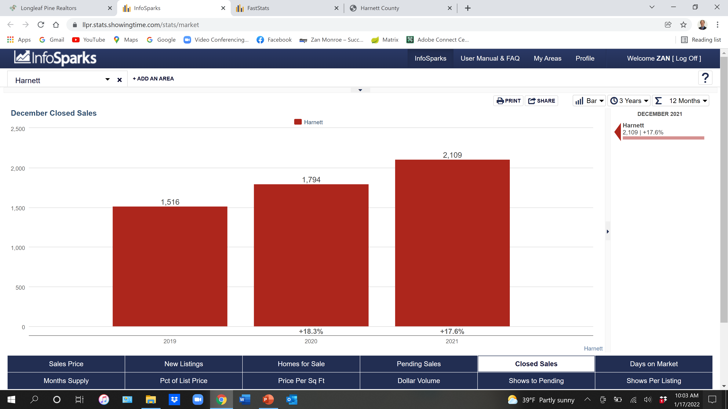

Slide 39
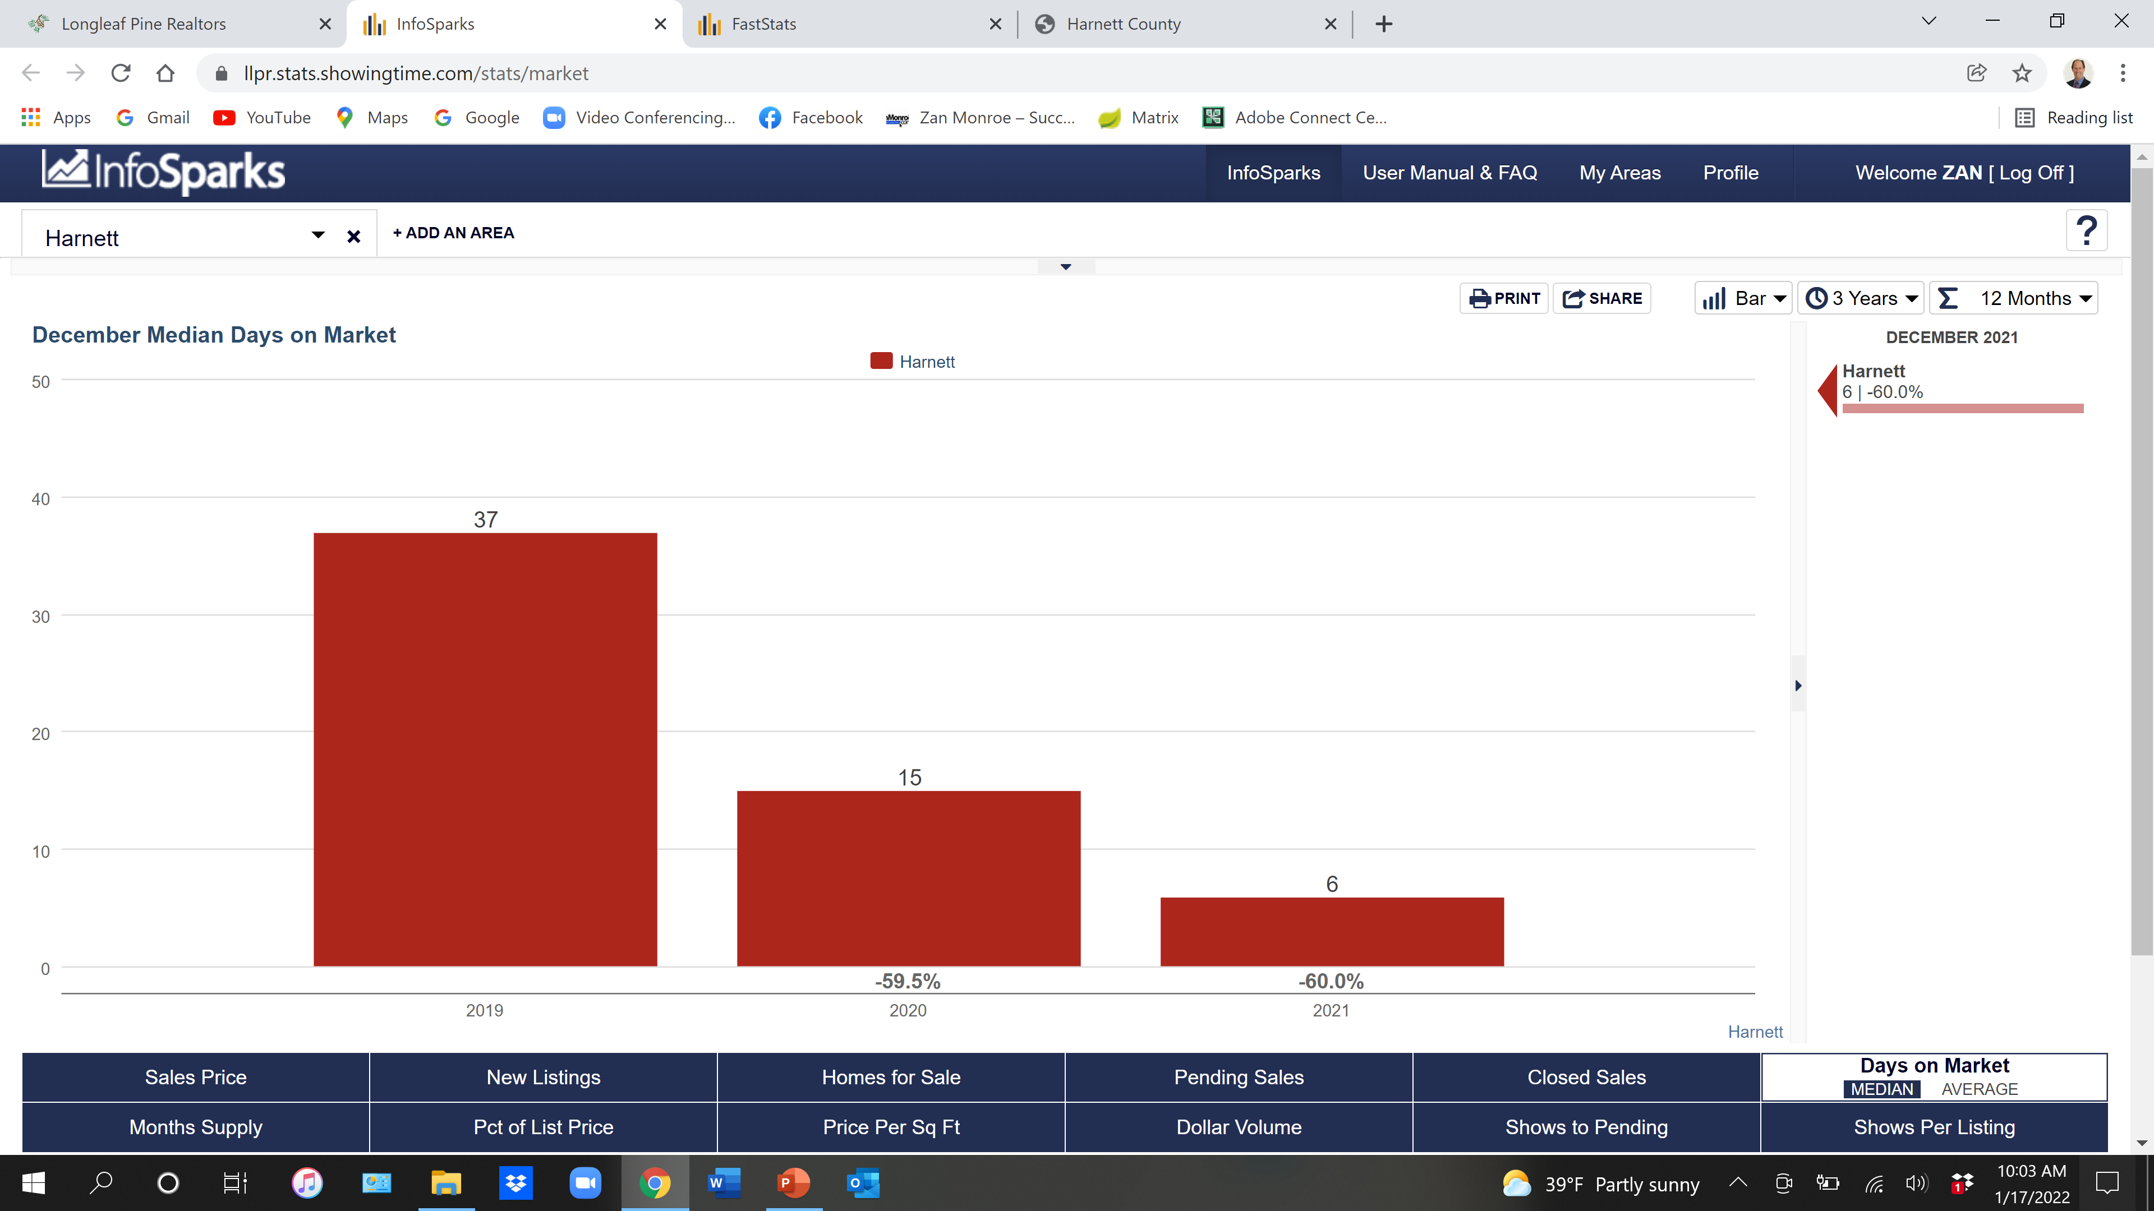

Slide 40
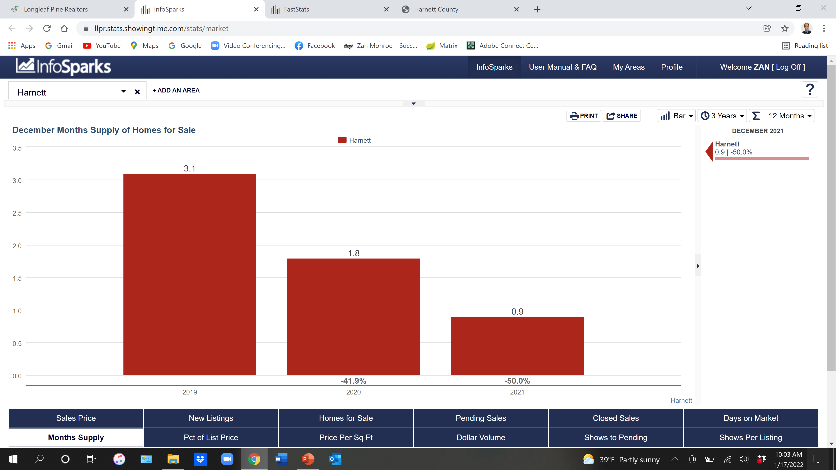

Slide 41
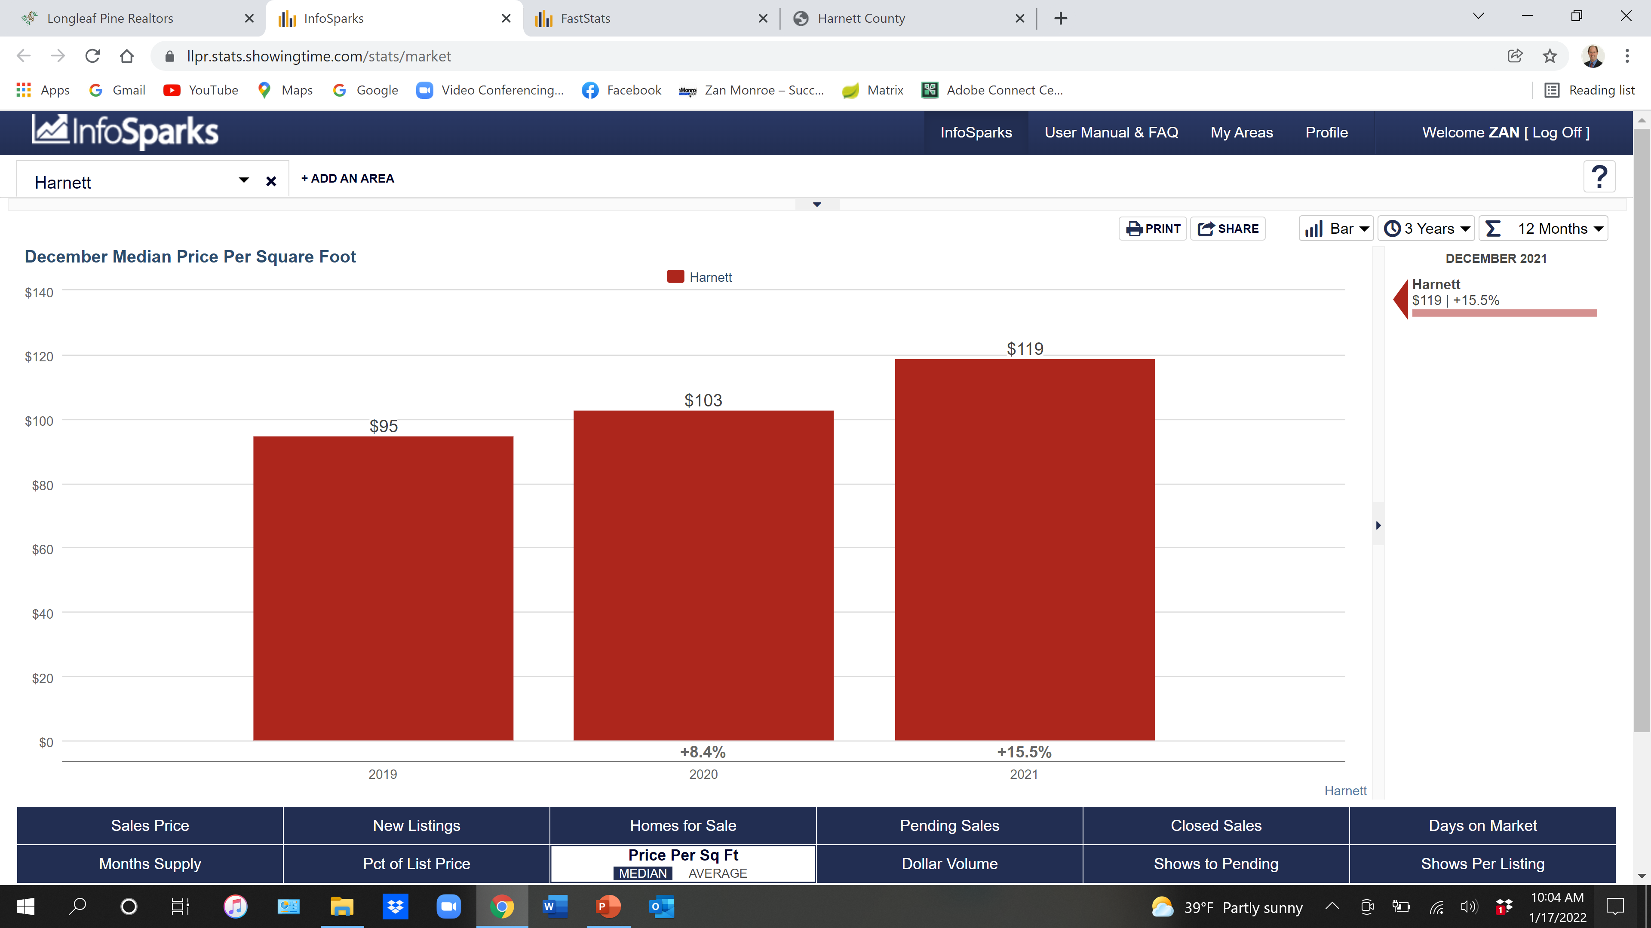

Slide 42
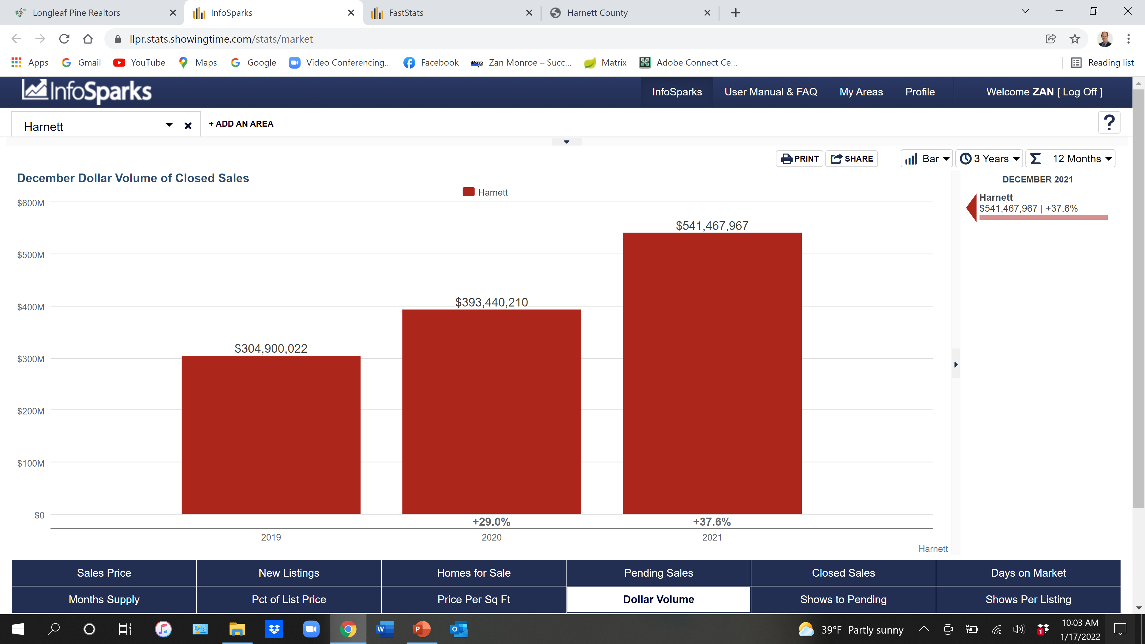

Slide 43
2022 Hoke County

Slide 45
Hoke County 2021 Single Family Existing
1,147 Closed
$205,000 Median Sales Price

Slide 47
Hoke County 2021 New Construction
154 Closed
$277,736 Median Sales Price

Slide 49
Hoke County 2021 Townhouse/Condo
5 Closed
$153,000 Median Sales Price

Slide 50
Hoke County Sales Price

Slide 51
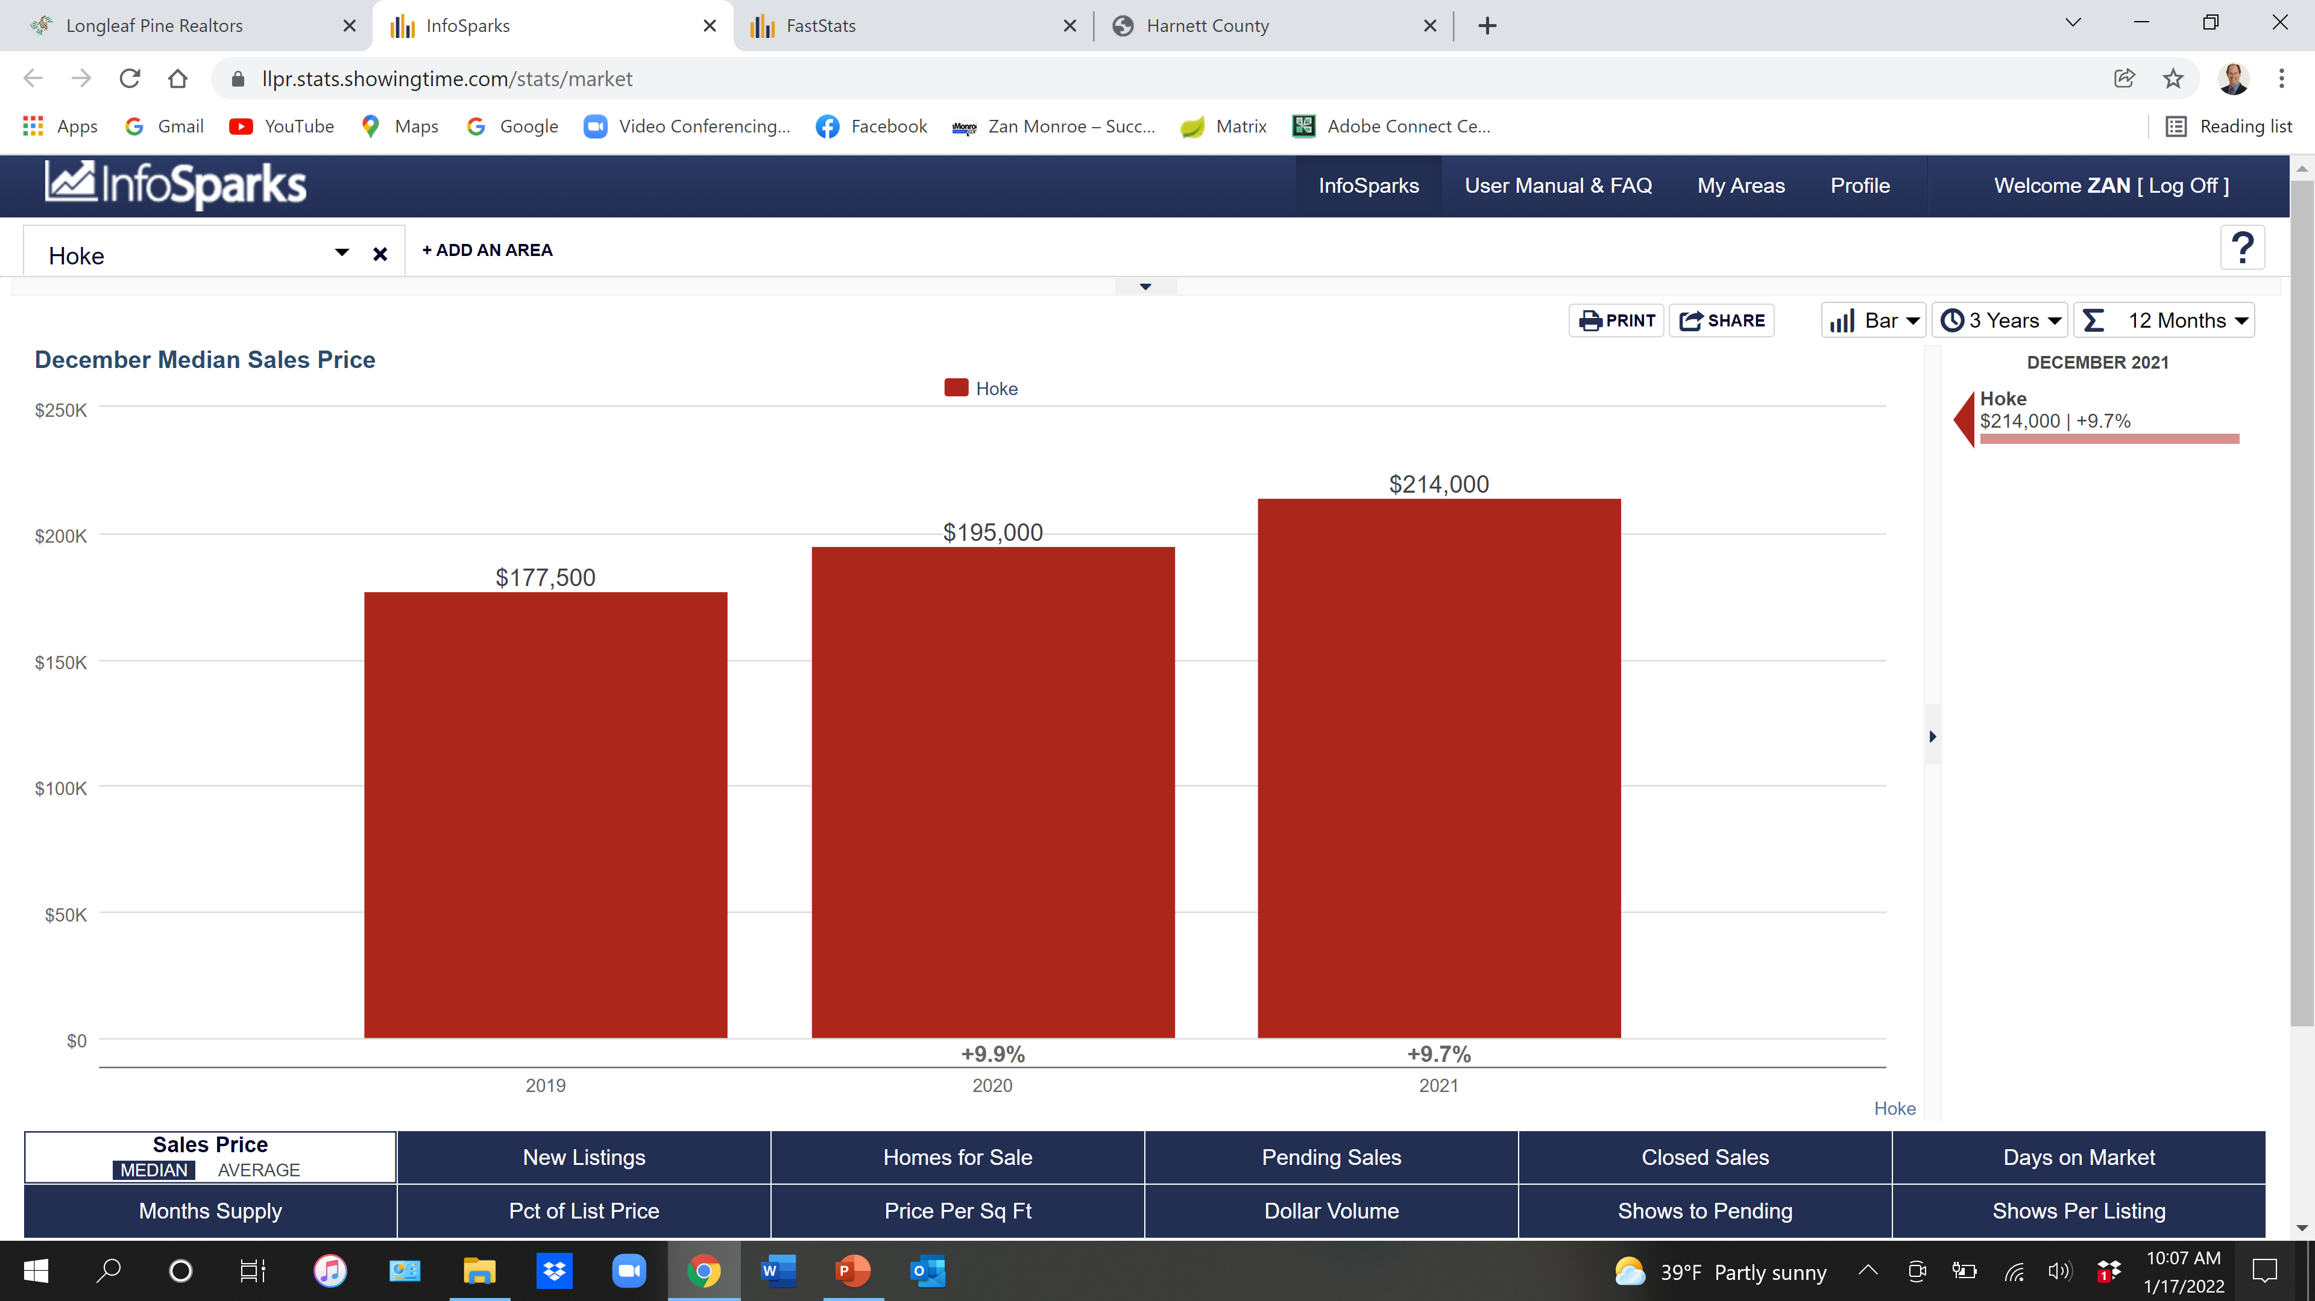

Slide 52
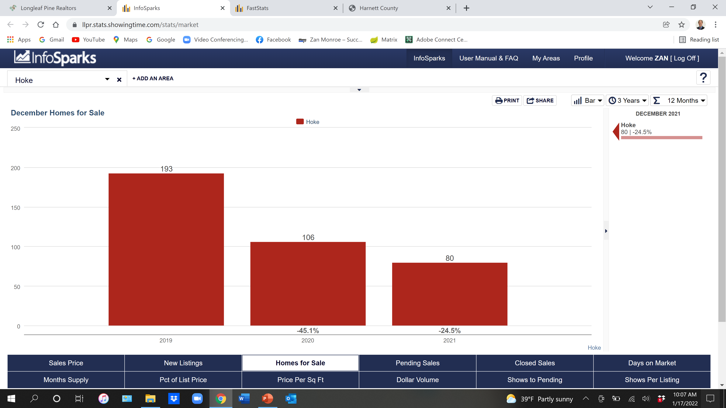

Slide 53
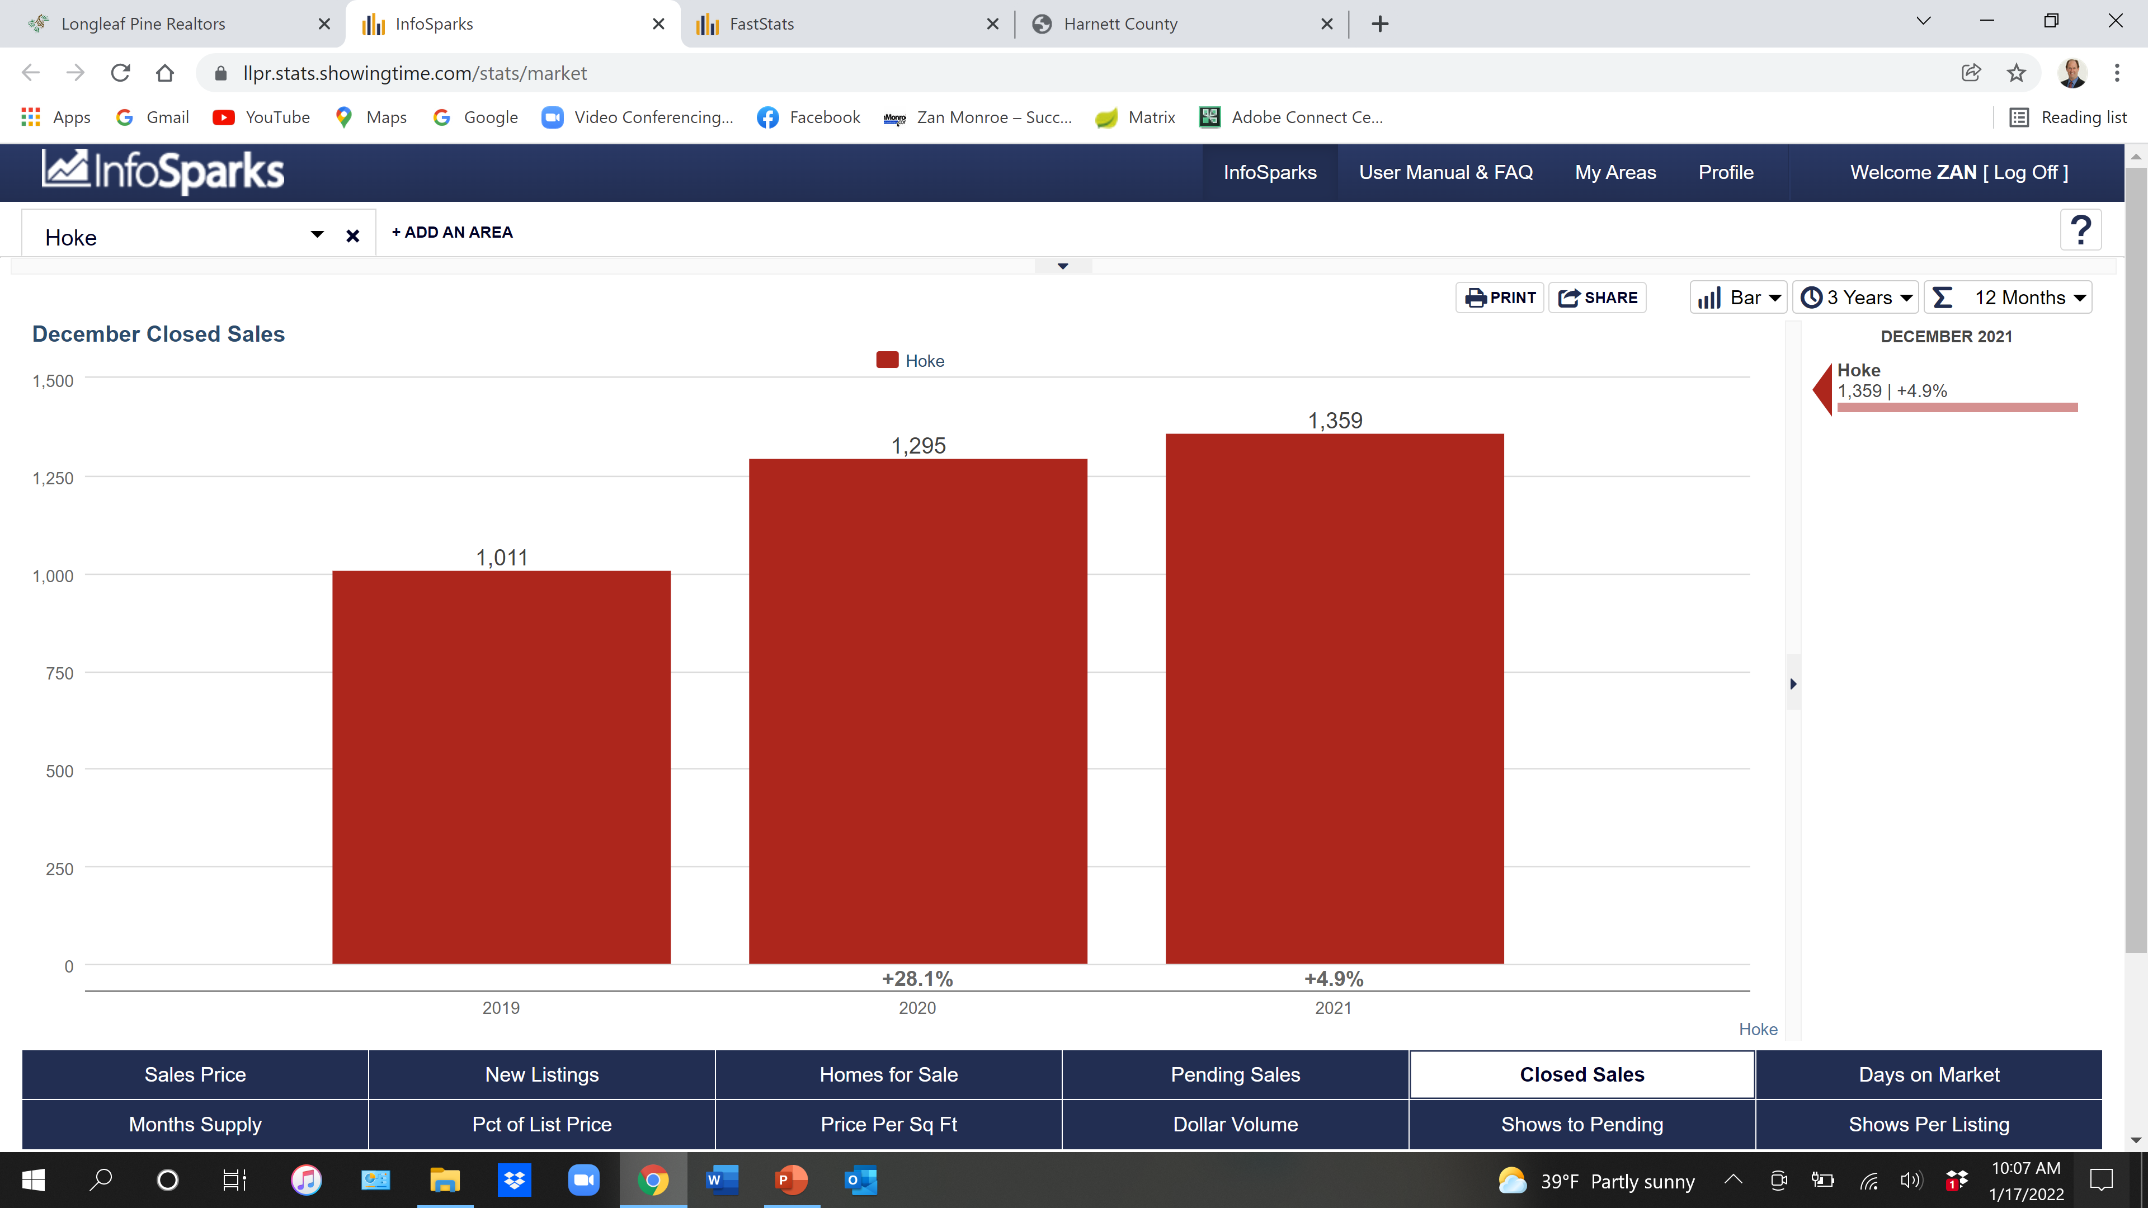

Slide 54
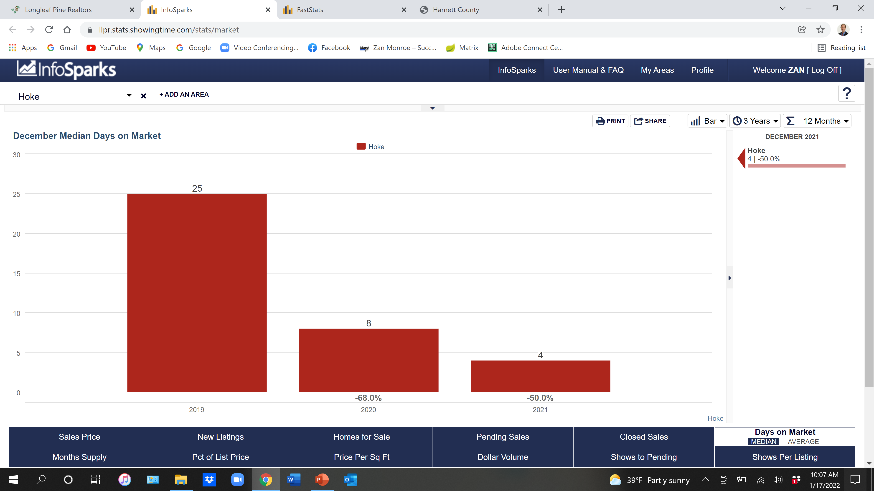

Slide 55
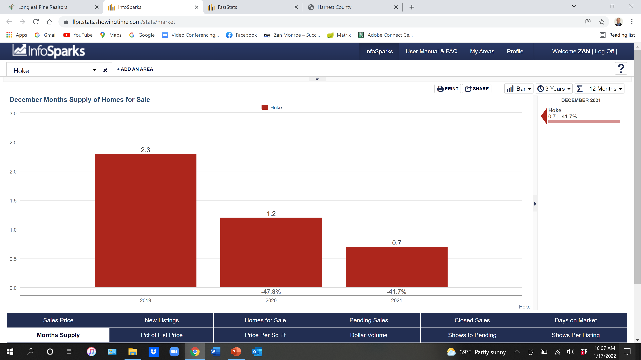

Slide 56
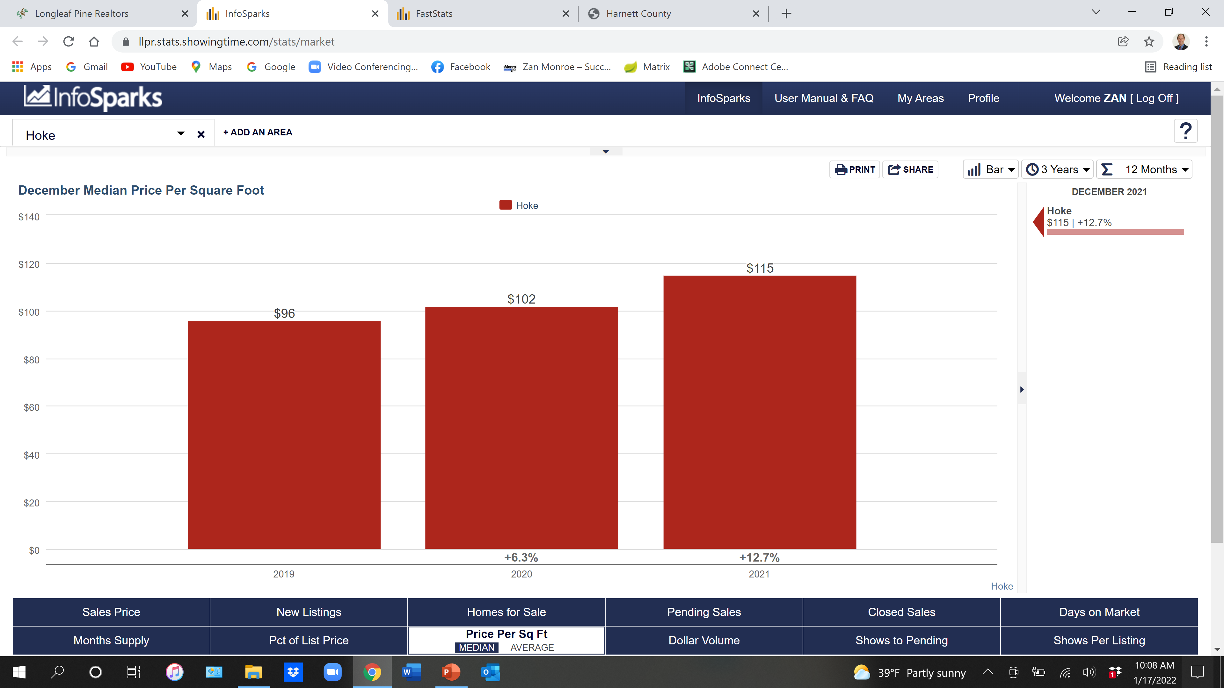

Slide 57
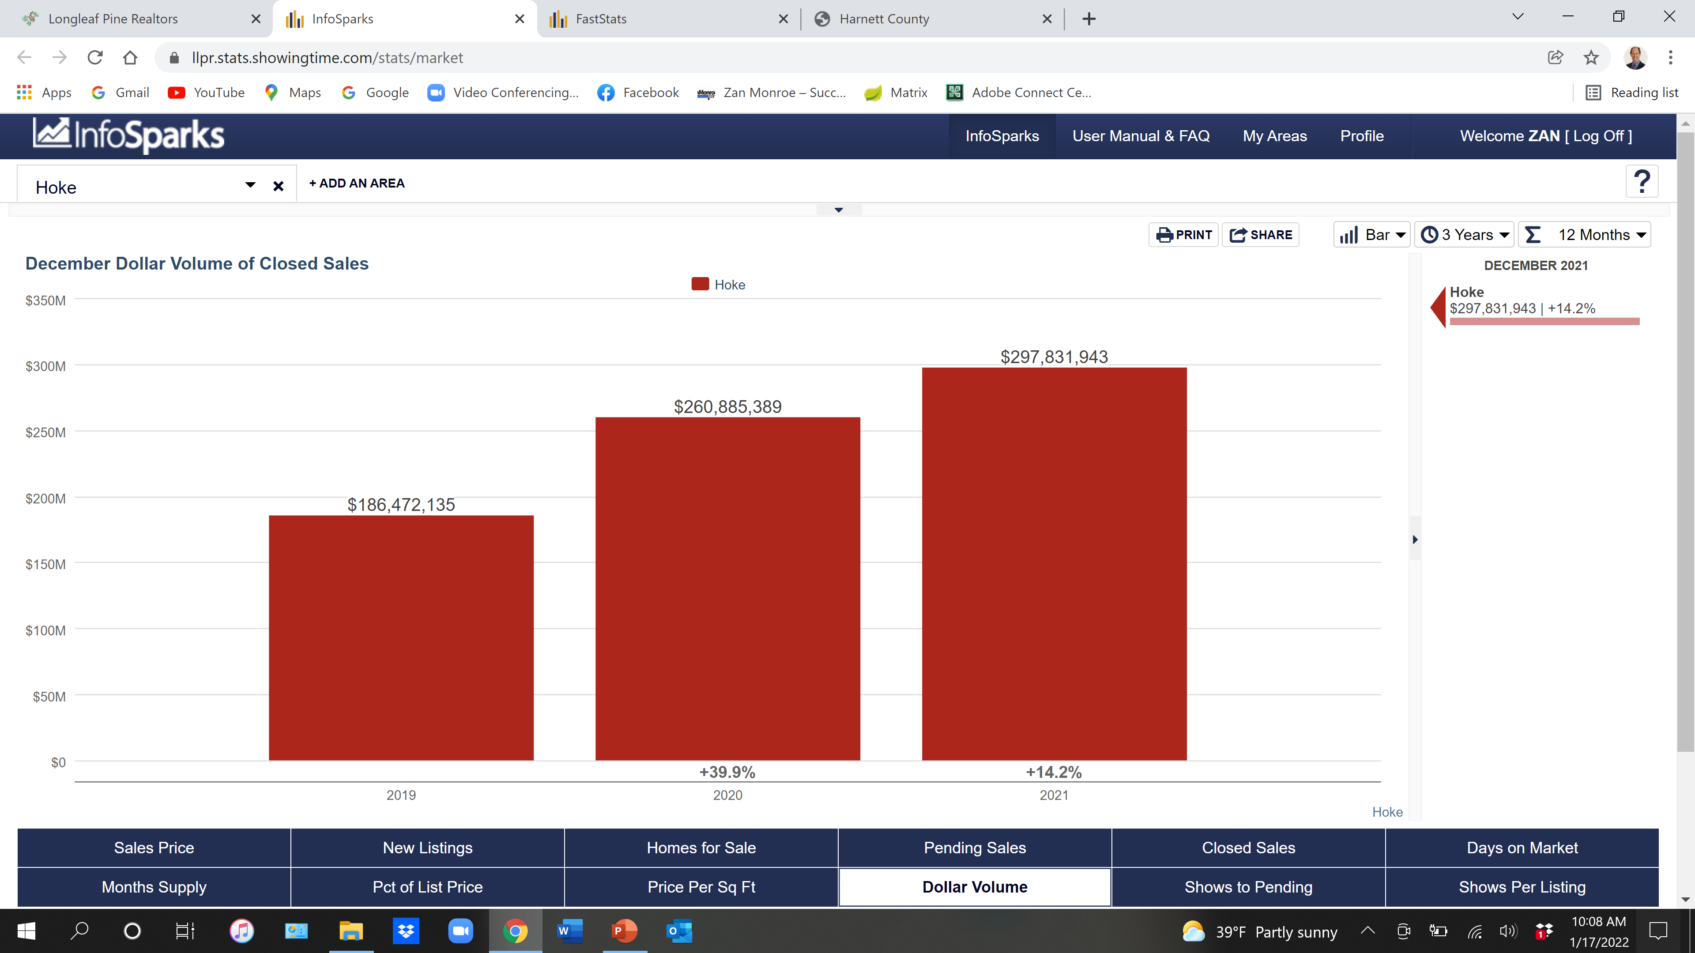

Slide 58
2022 Lee County

Slide 59
Lee County 2021 Single Family Existing
536 Closed
$245,000 Median Sales Price

Slide 60
Lee County 2021 New Construction
129 Closed
$250,500 Median Sales Price

Slide 61
Lee County 2021 Townhouse/Condo
18 Closed
$179,000 Median Sales Price

Slide 62
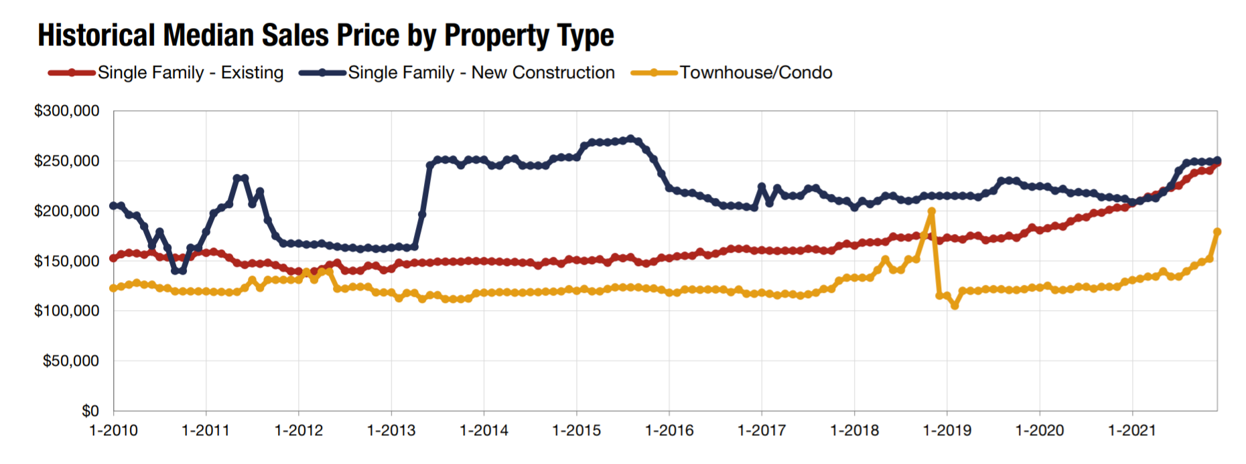
Lee County Sales Price

Slide 63
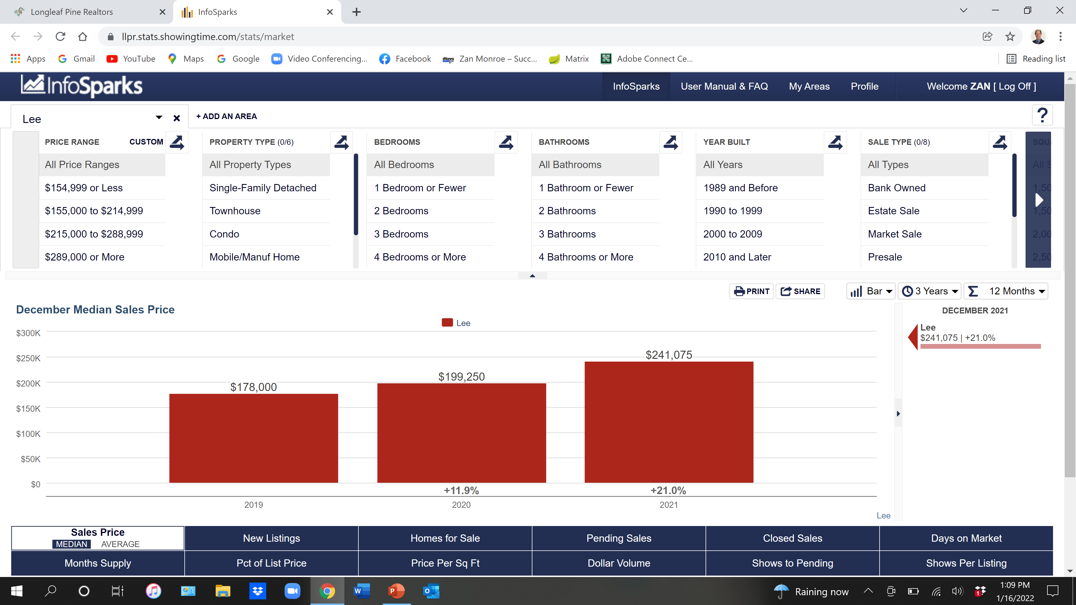

Slide 64
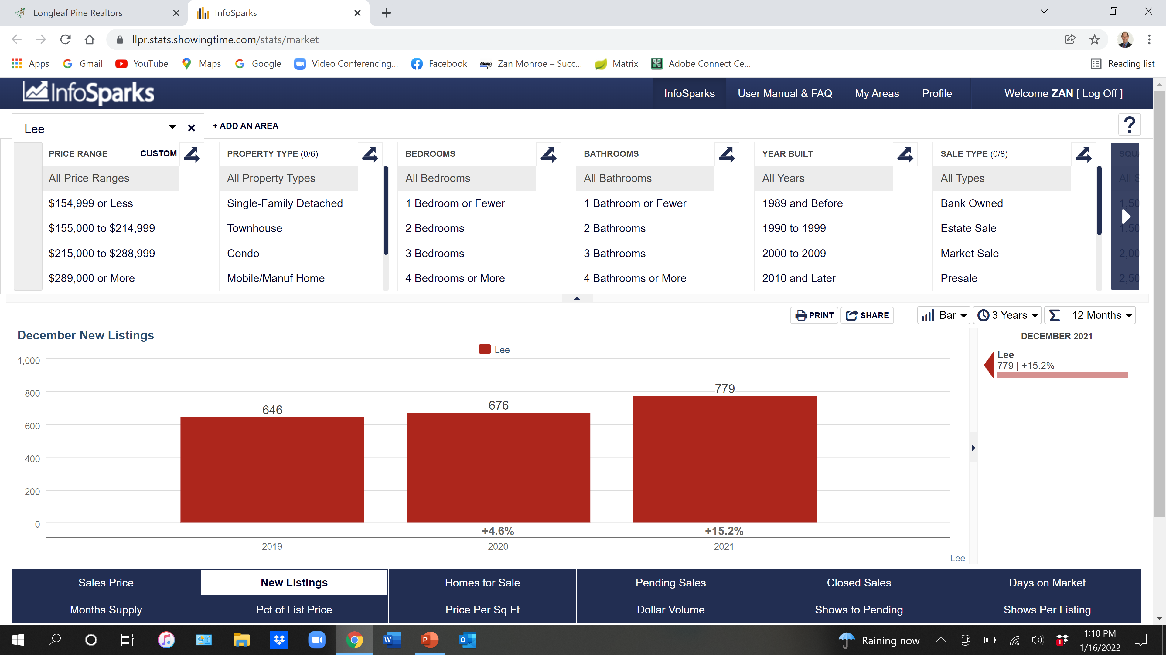

Slide 65
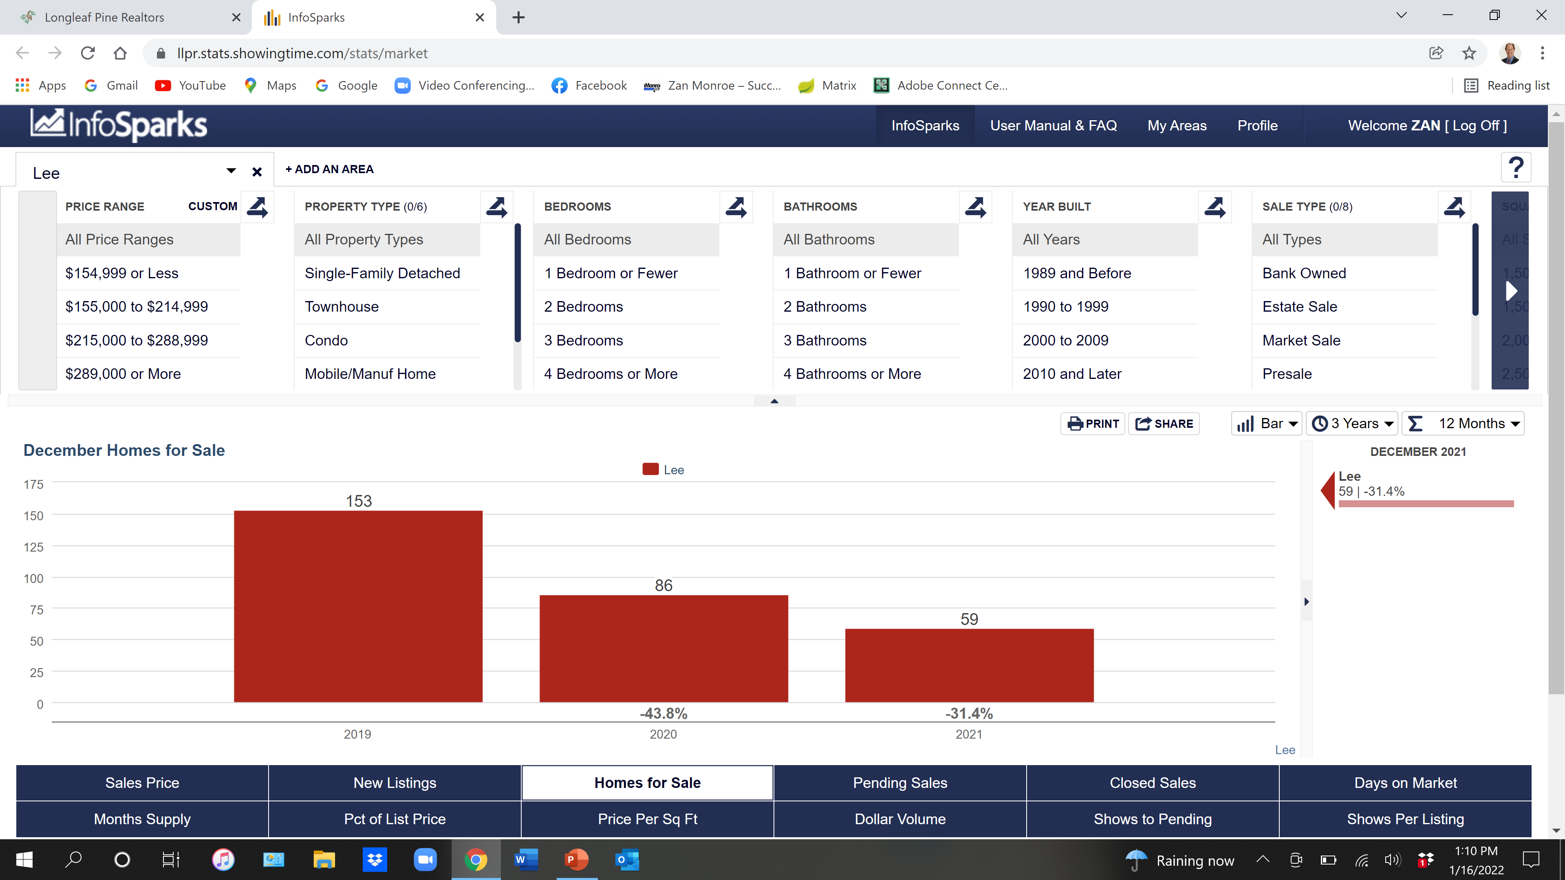

Slide 66
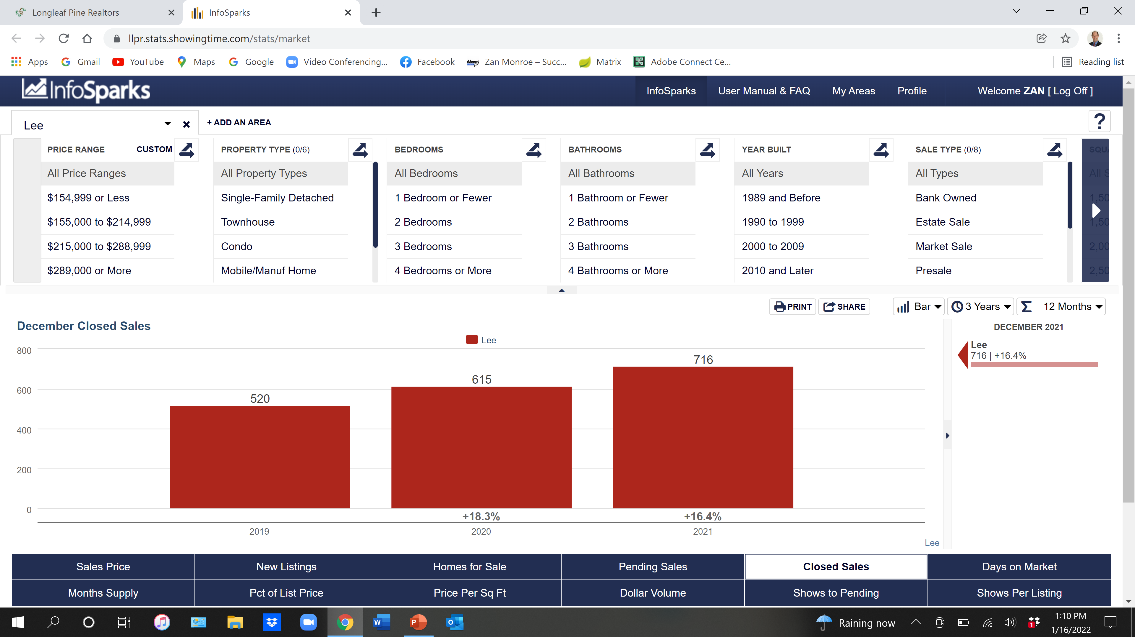

Slide 67
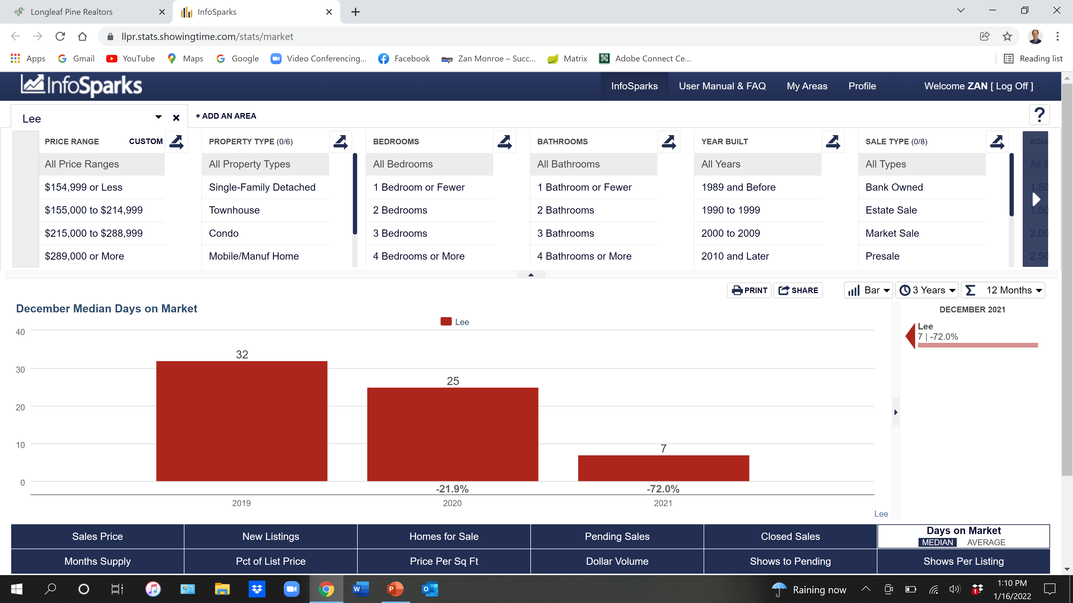

Slide 68
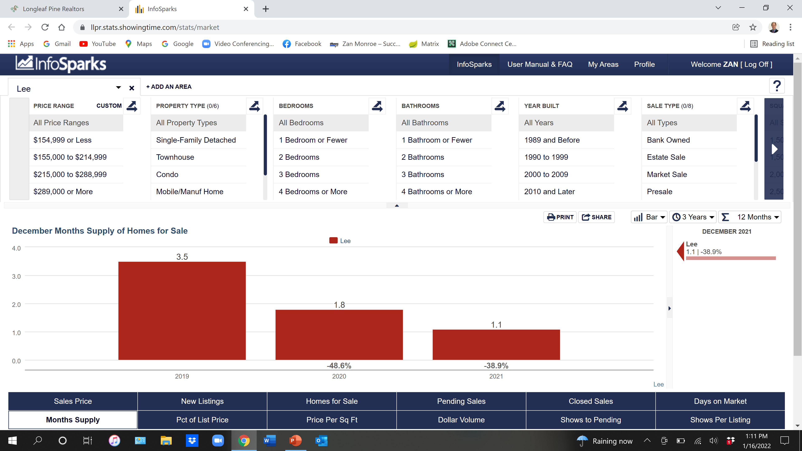

Slide 69
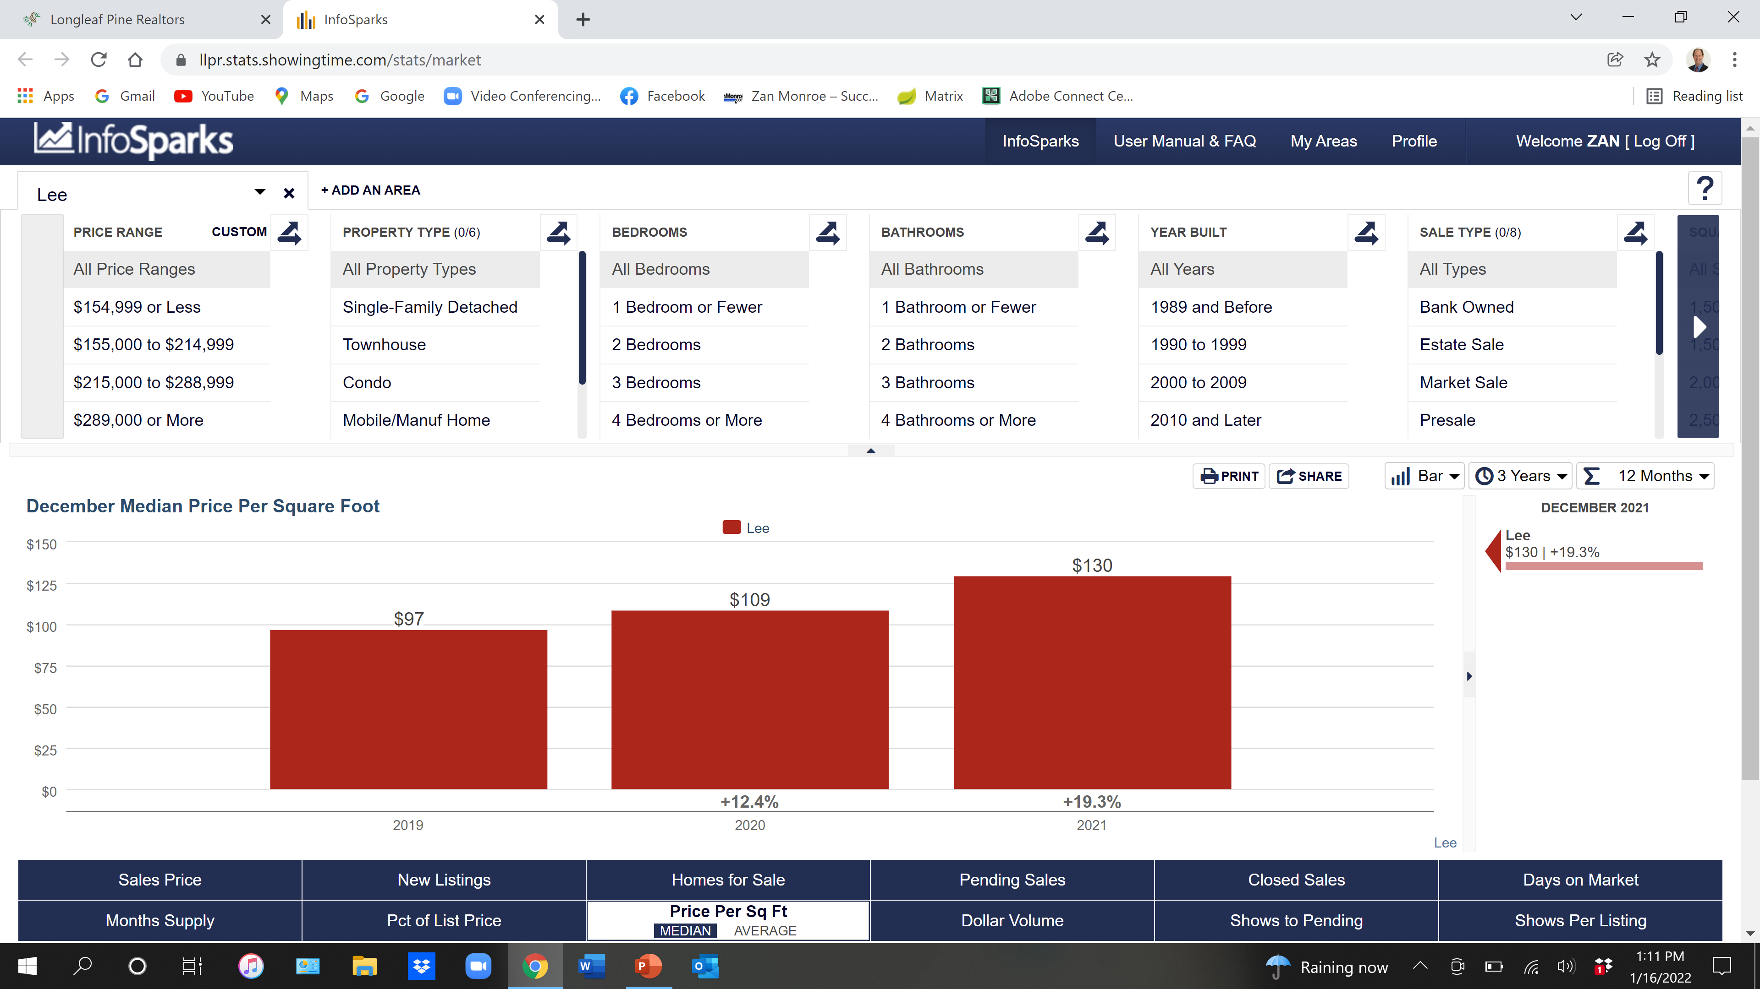

Slide 70
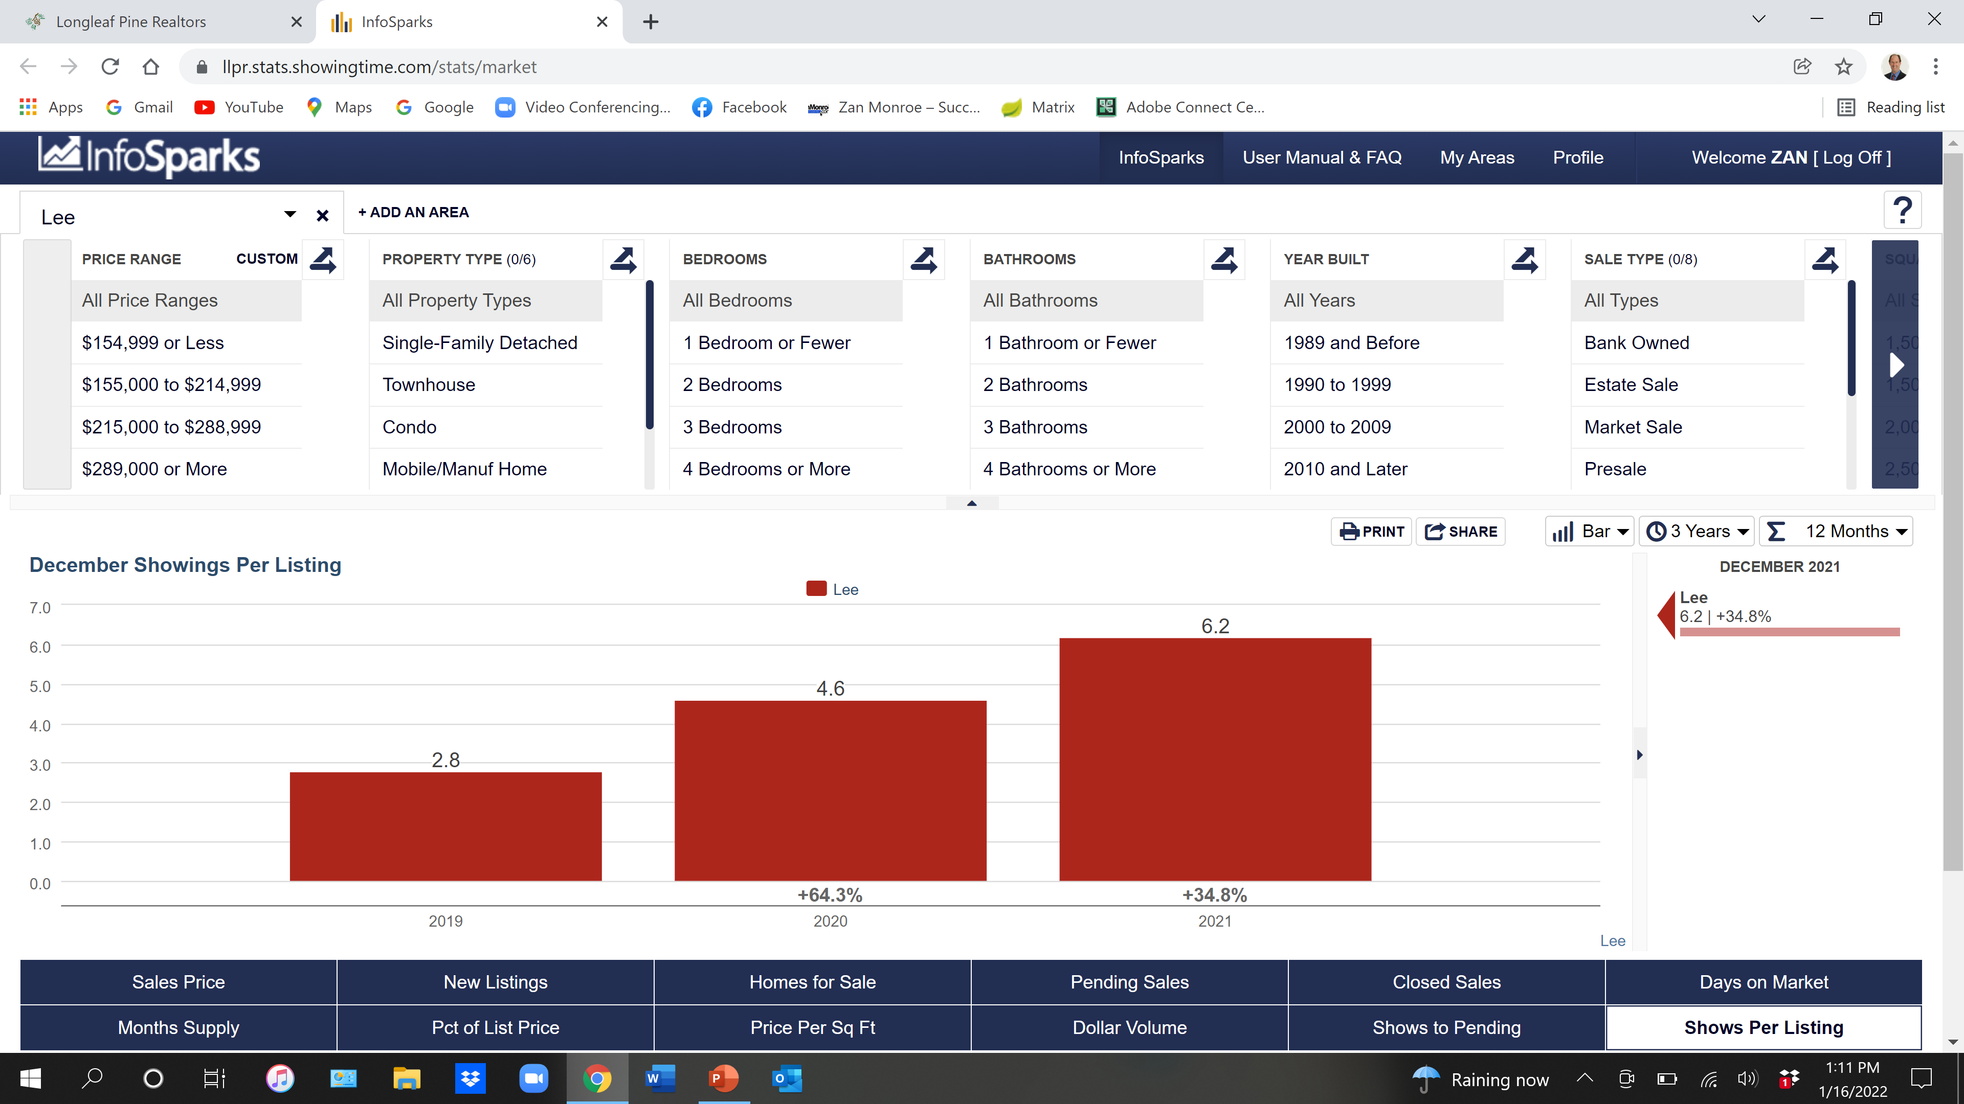

Slide 71
2022 Robeson County

Slide 72
Robeson County 2021 Single Family Existing
400 Closed
$152,000 Median Sales Price

Slide 73
Robeson County 2021 New Construction
36 Closed
$212,950 Median Sales Price

Slide 74
Robeson County 2021 Townhouse/Condo
19 Closed
$131,440 Median Sales Price

Slide 75
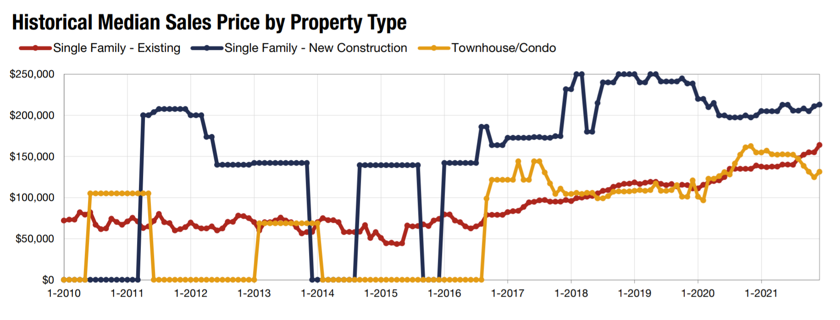
Robeson County Sales Price

Slide 76
2022 State of the Real Estate Market

